Slide 1
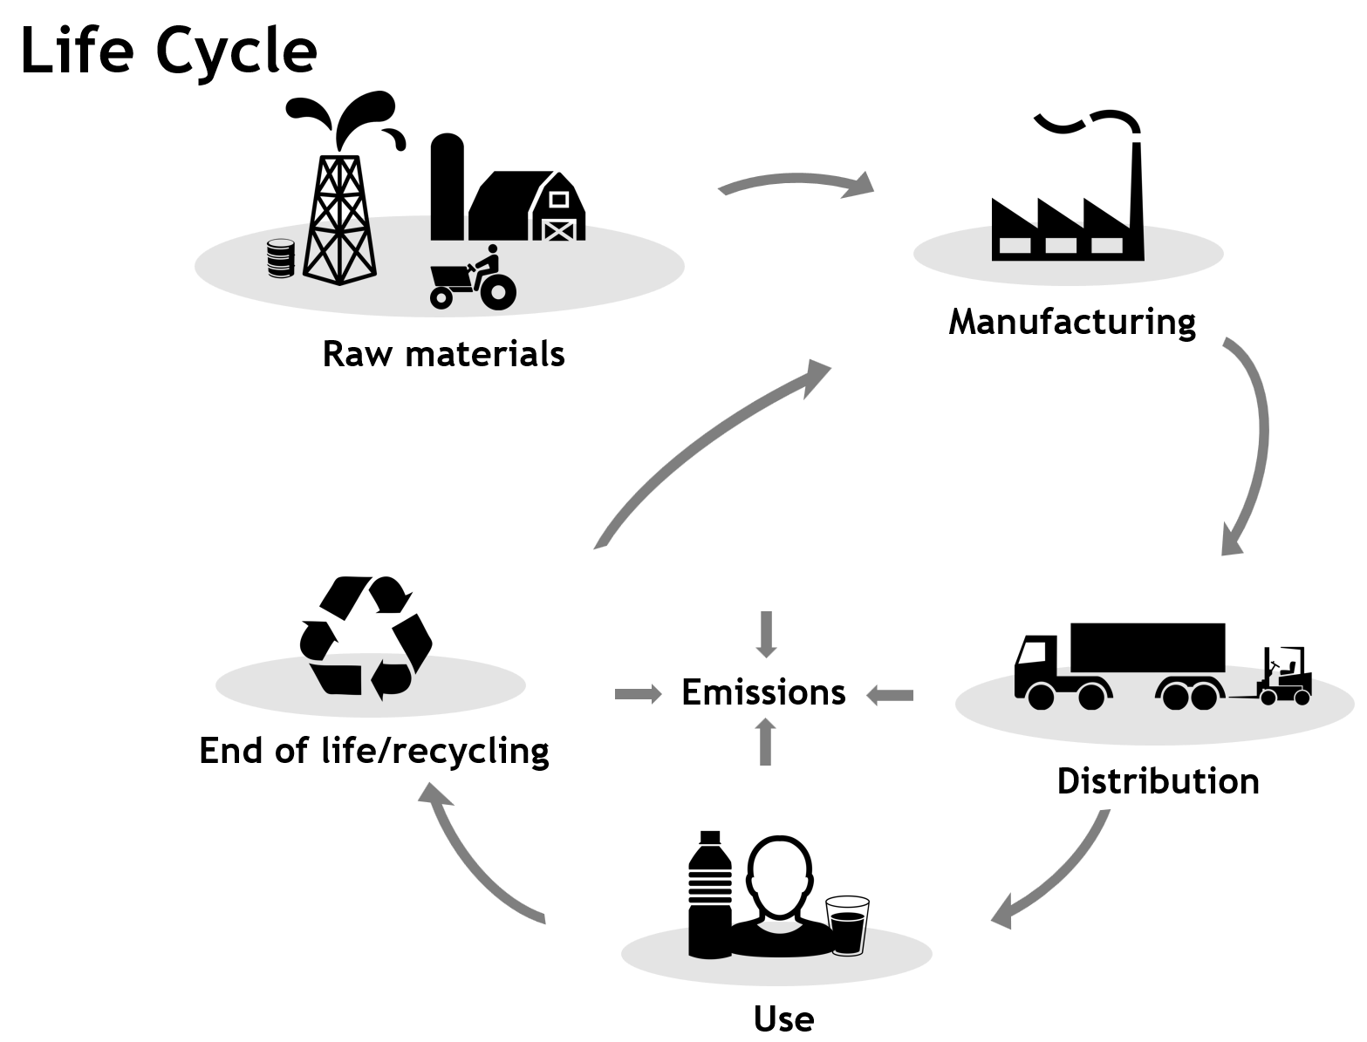
Life-cycle assessment of food systems methods, tools and databases
Workshop of the Data Science Initiative for Africa (DSI-A) Training Programme, Durban, 10 July 2023 Bernd Franke and team

Slide 2
Part 1: Life Cycle Assessment (LCA)

Slide 3
Product LCA - Definition
“
Life Cycle Assessment is a compilation and evaluation of the inputs, outputs and the potential environmental impacts of a product system throughout its life cycle
–ISO 14040

Slide 4
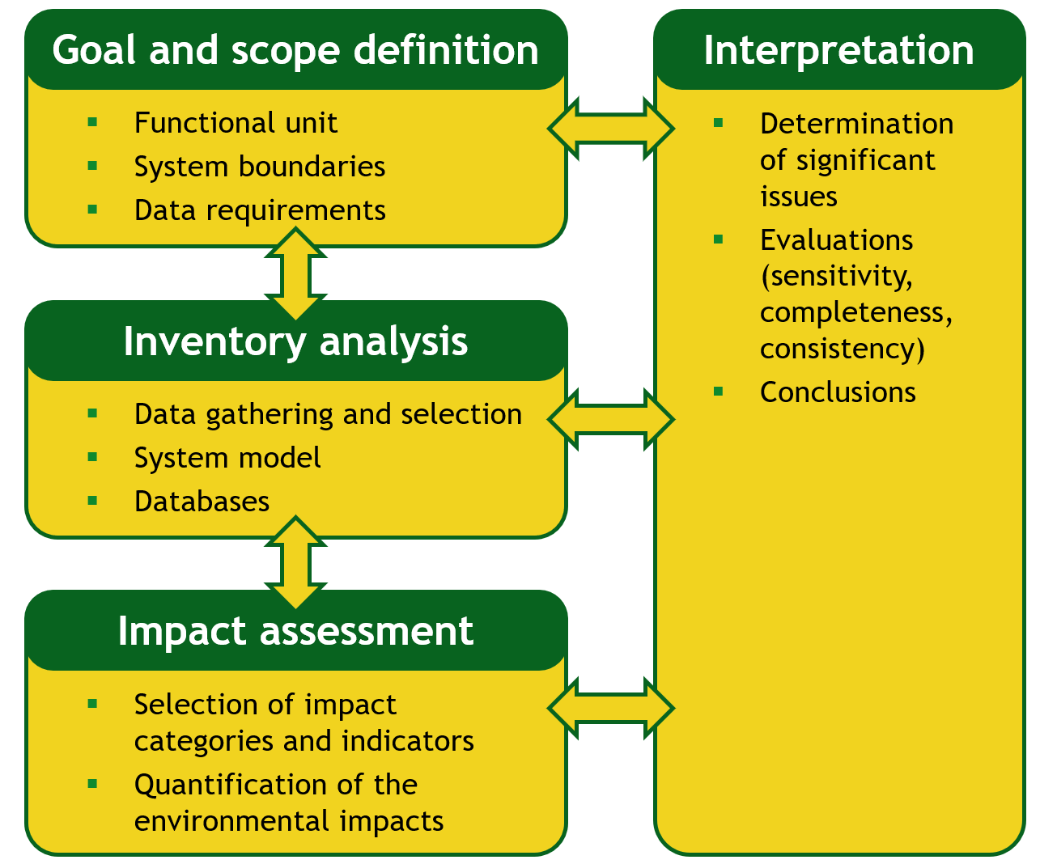
LCA Framework according to ISO 14040/44

Slide 5






Life Cycle Impact Assessment in LCA
Classification
Characterization
Activities
Inventory
Impact Categories
Impact Indicator
N2O
CO2
Global Warming
Global Warming Potential
CO2-equivalents
CH4
SF6
Acidification
SO2
Acidification Potential
SO2-equivalents
Eutrophication
NOx
NH3
…
NH4
Eutrophication Potential
PO4-equivalents
Notes:
All icons are public domain

Slide 6
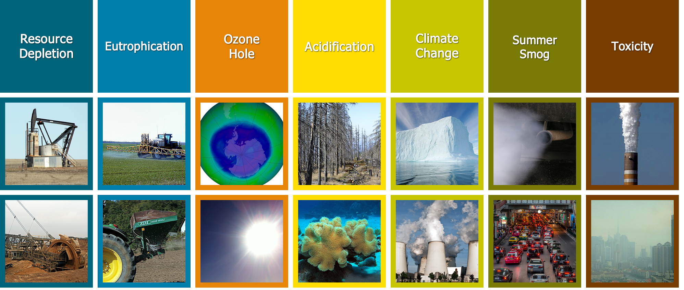
Life Cycle Impact Assessment in LCA

Slide 7
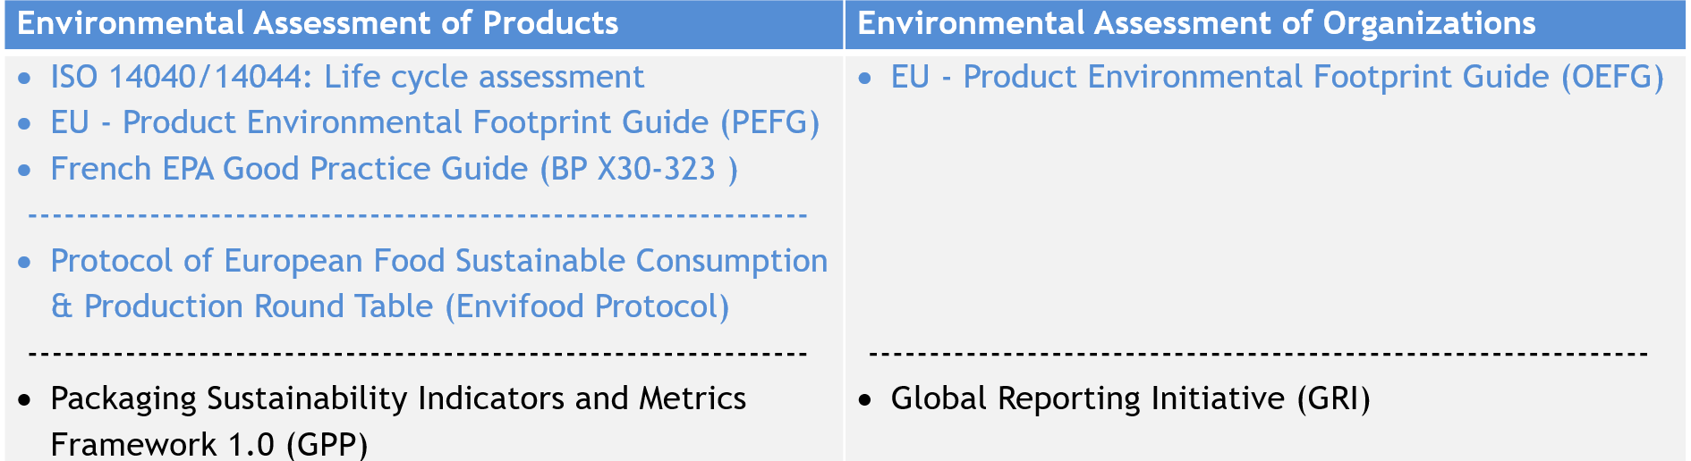
Standards and Guidelines (1)

Slide 8
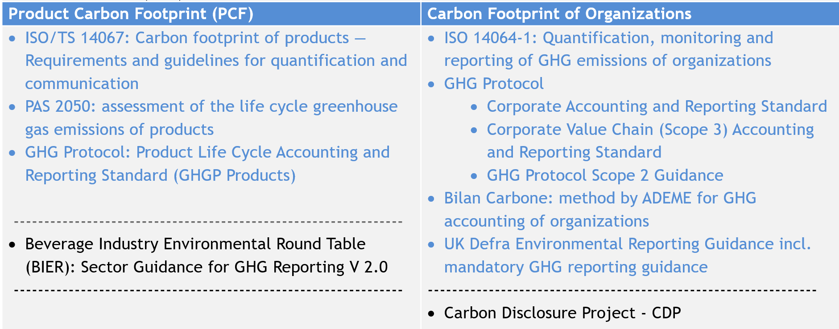
Standards and Guidelines (2)

Slide 9
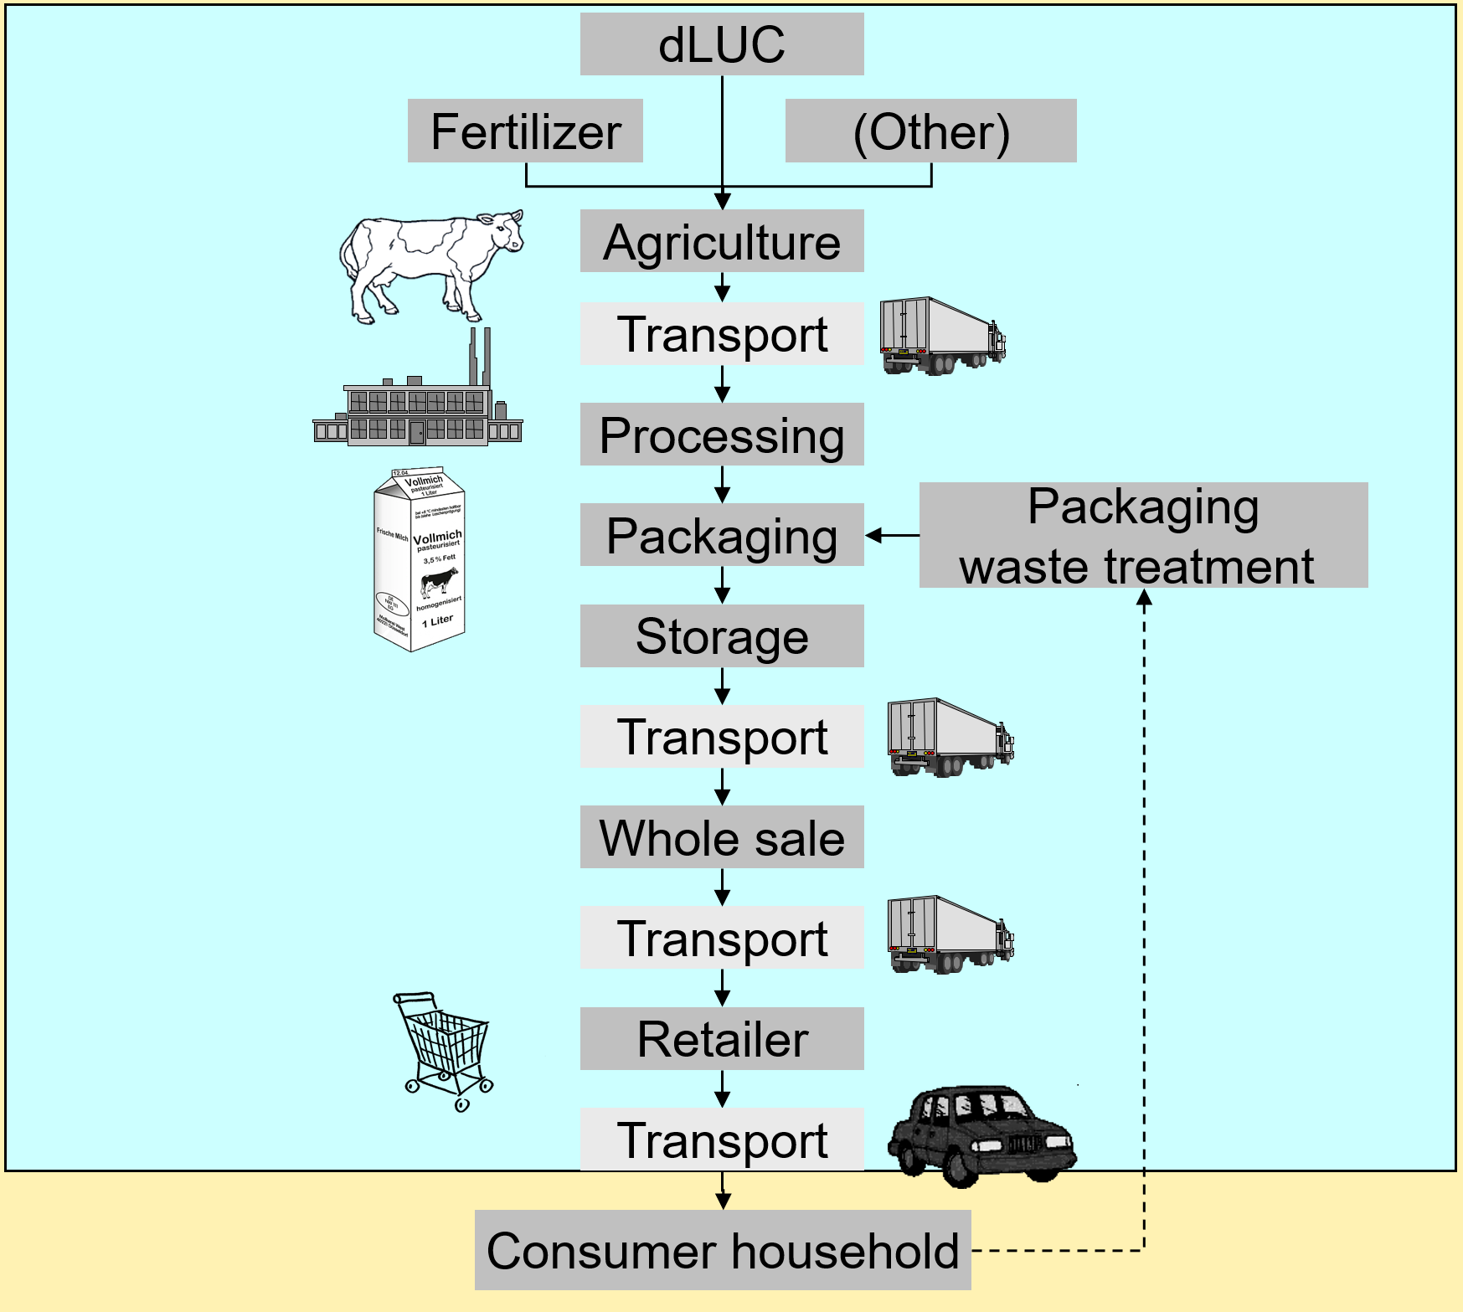
System boundaries: food system vs. beverage container

Slide 10
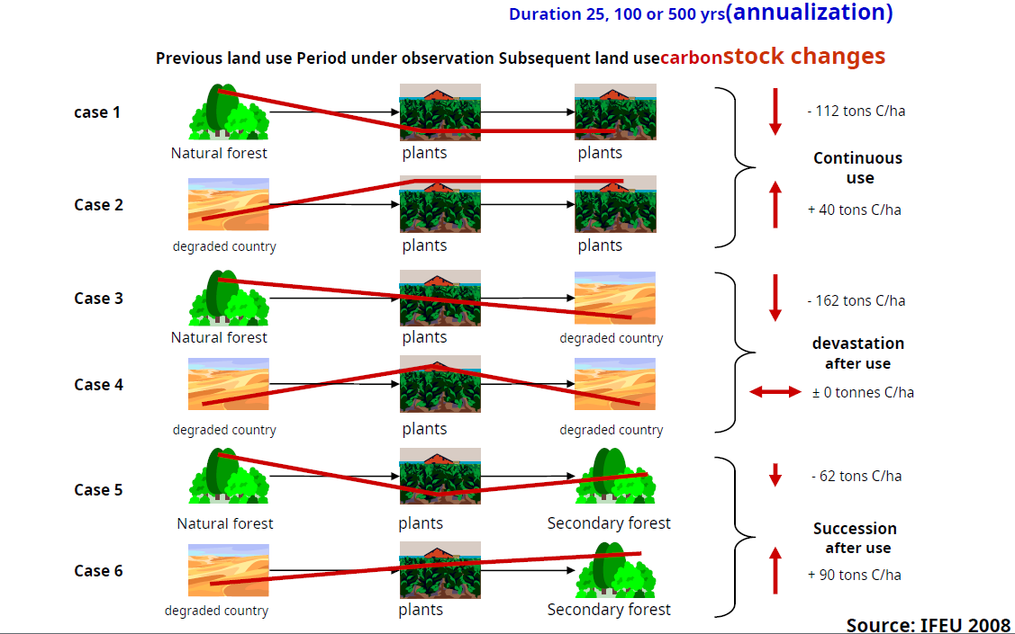
Direct land use change (dLUC)

Slide 11
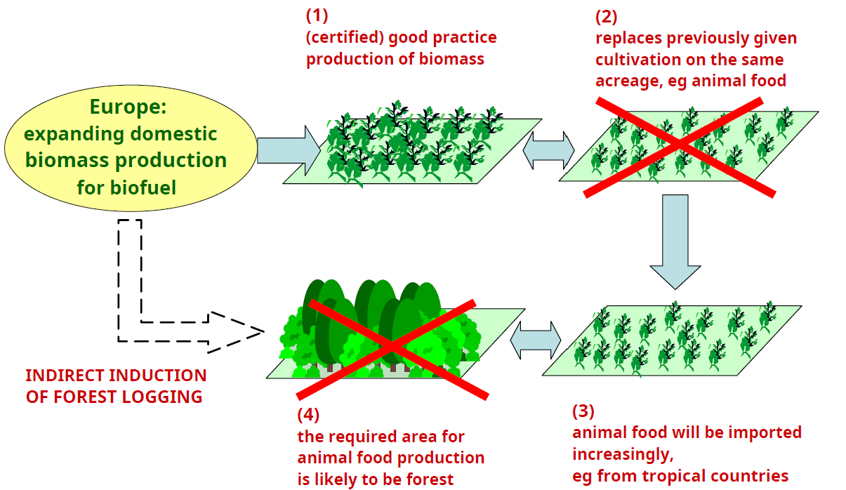
Indirect land use change (iLUC)

Slide 12

Apples

Slide 13
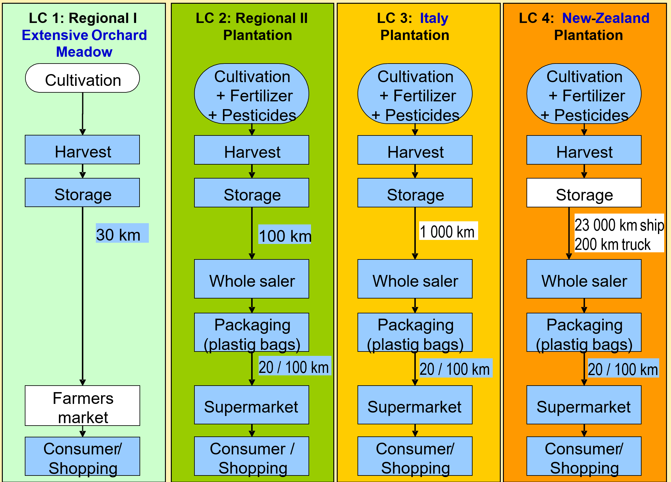
Apples: life cycle scenarios

Slide 14
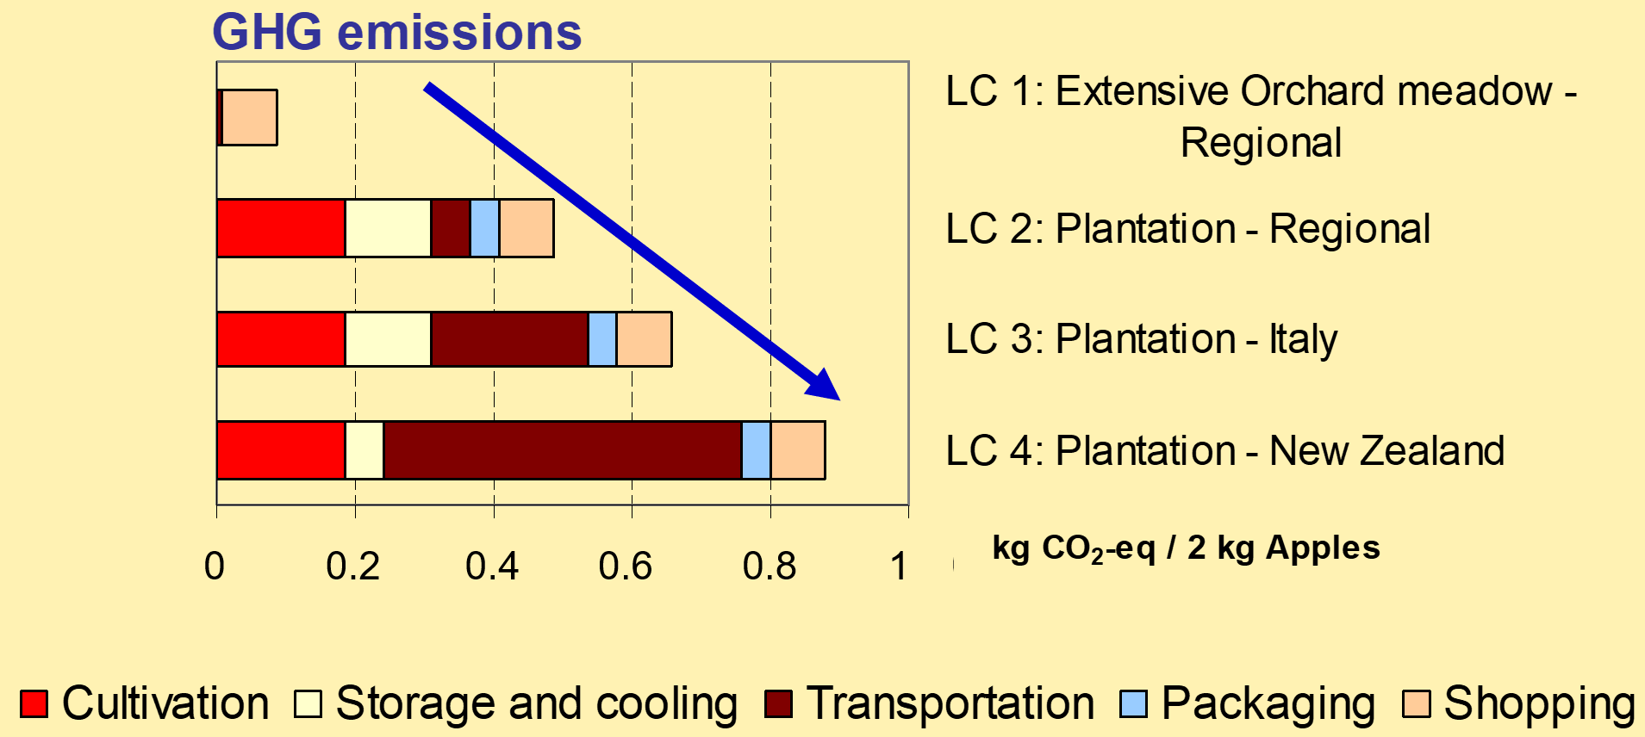
Apples life cycle: results

Slide 15
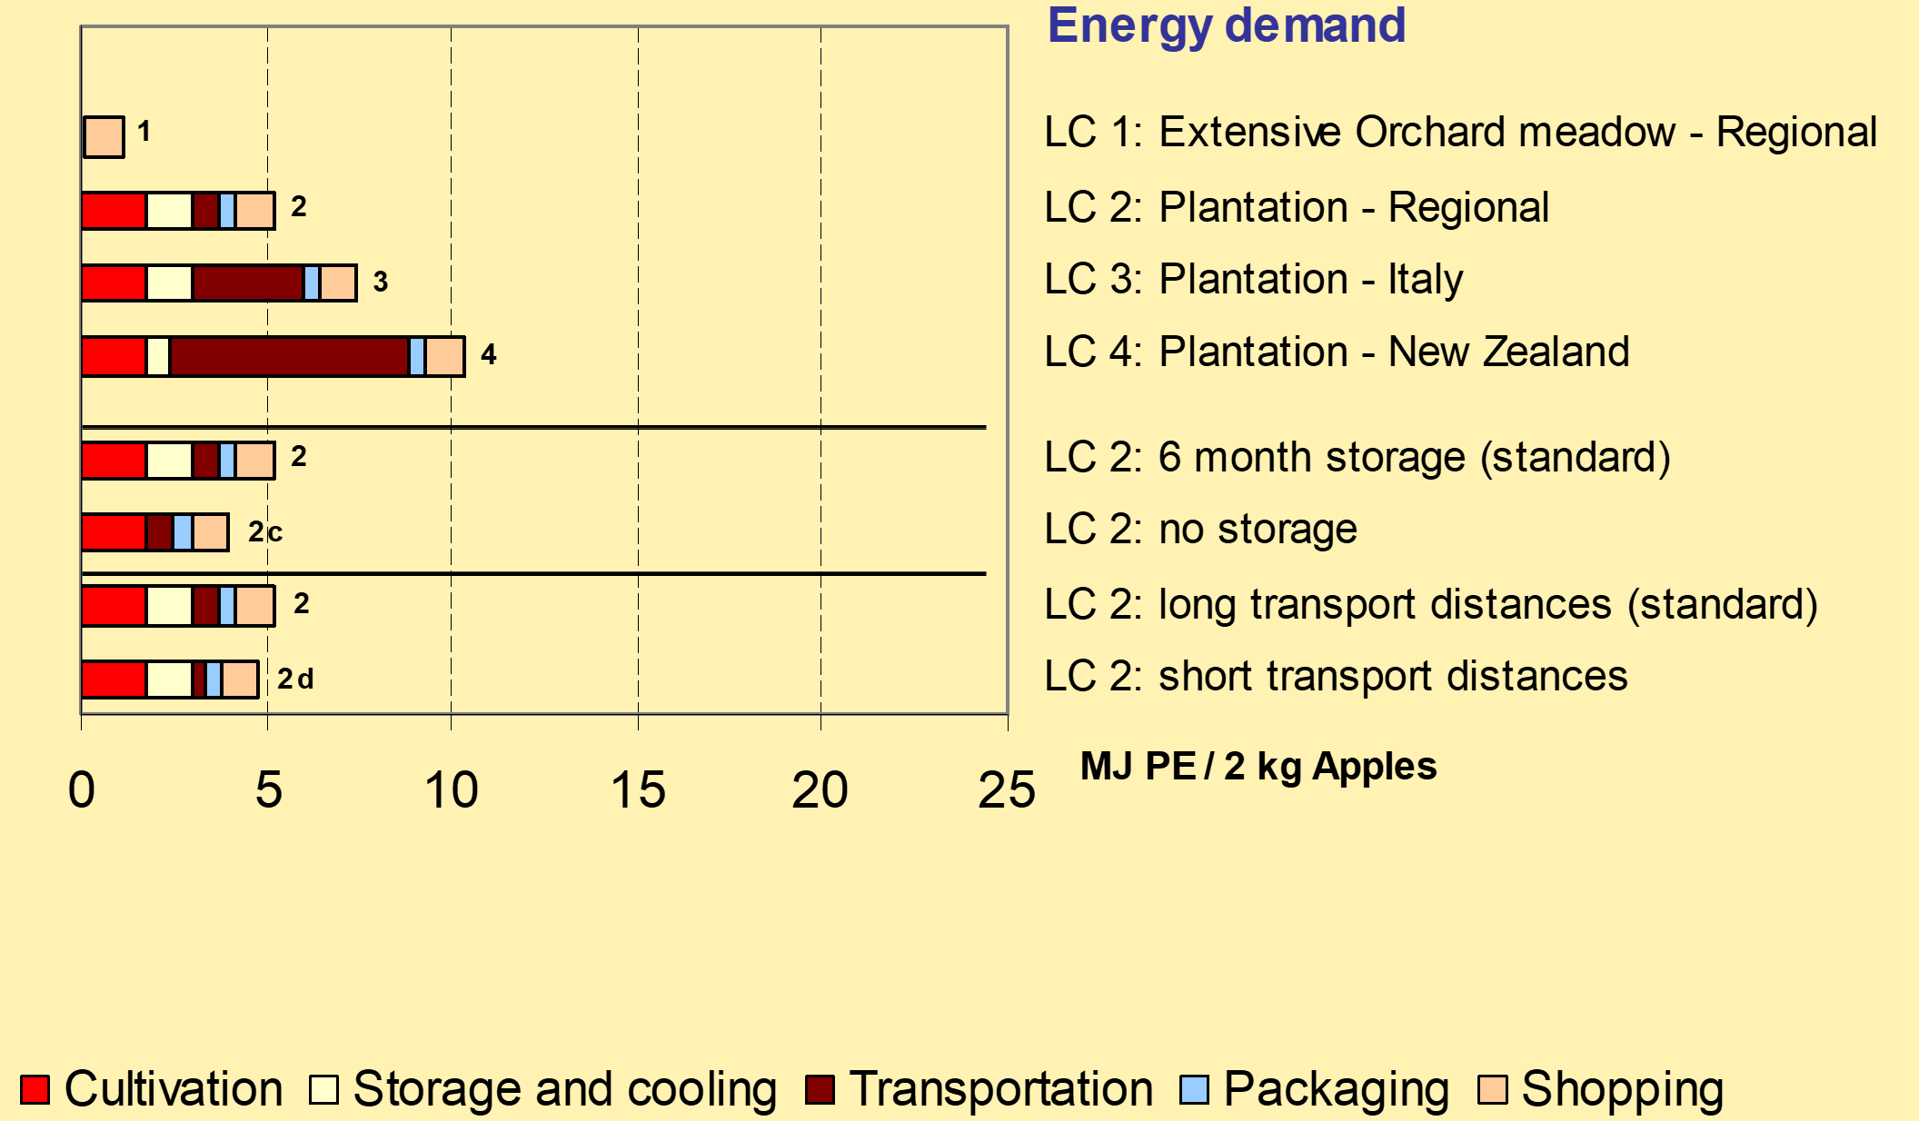
Apples life cycle: sensitivity assessment

Slide 16
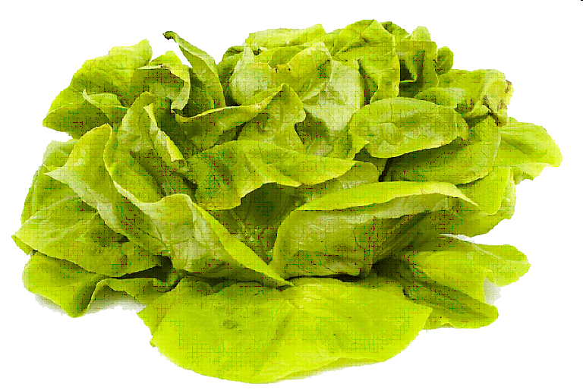
Lettuce

Slide 17
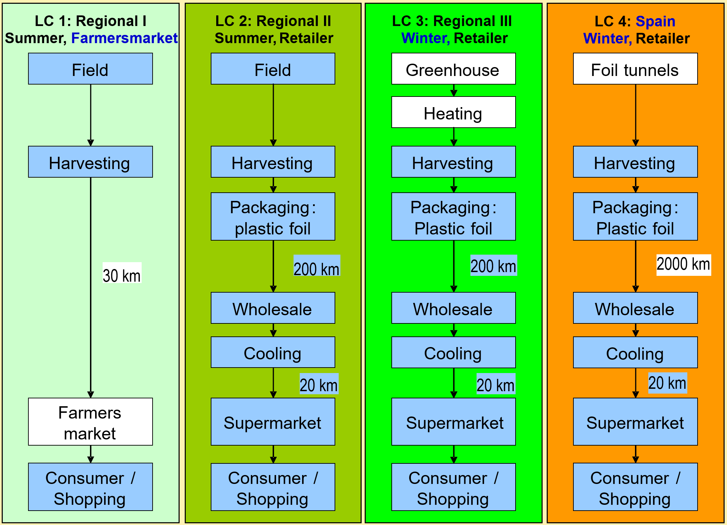
Lettuce: life cycle scenarios

Slide 18
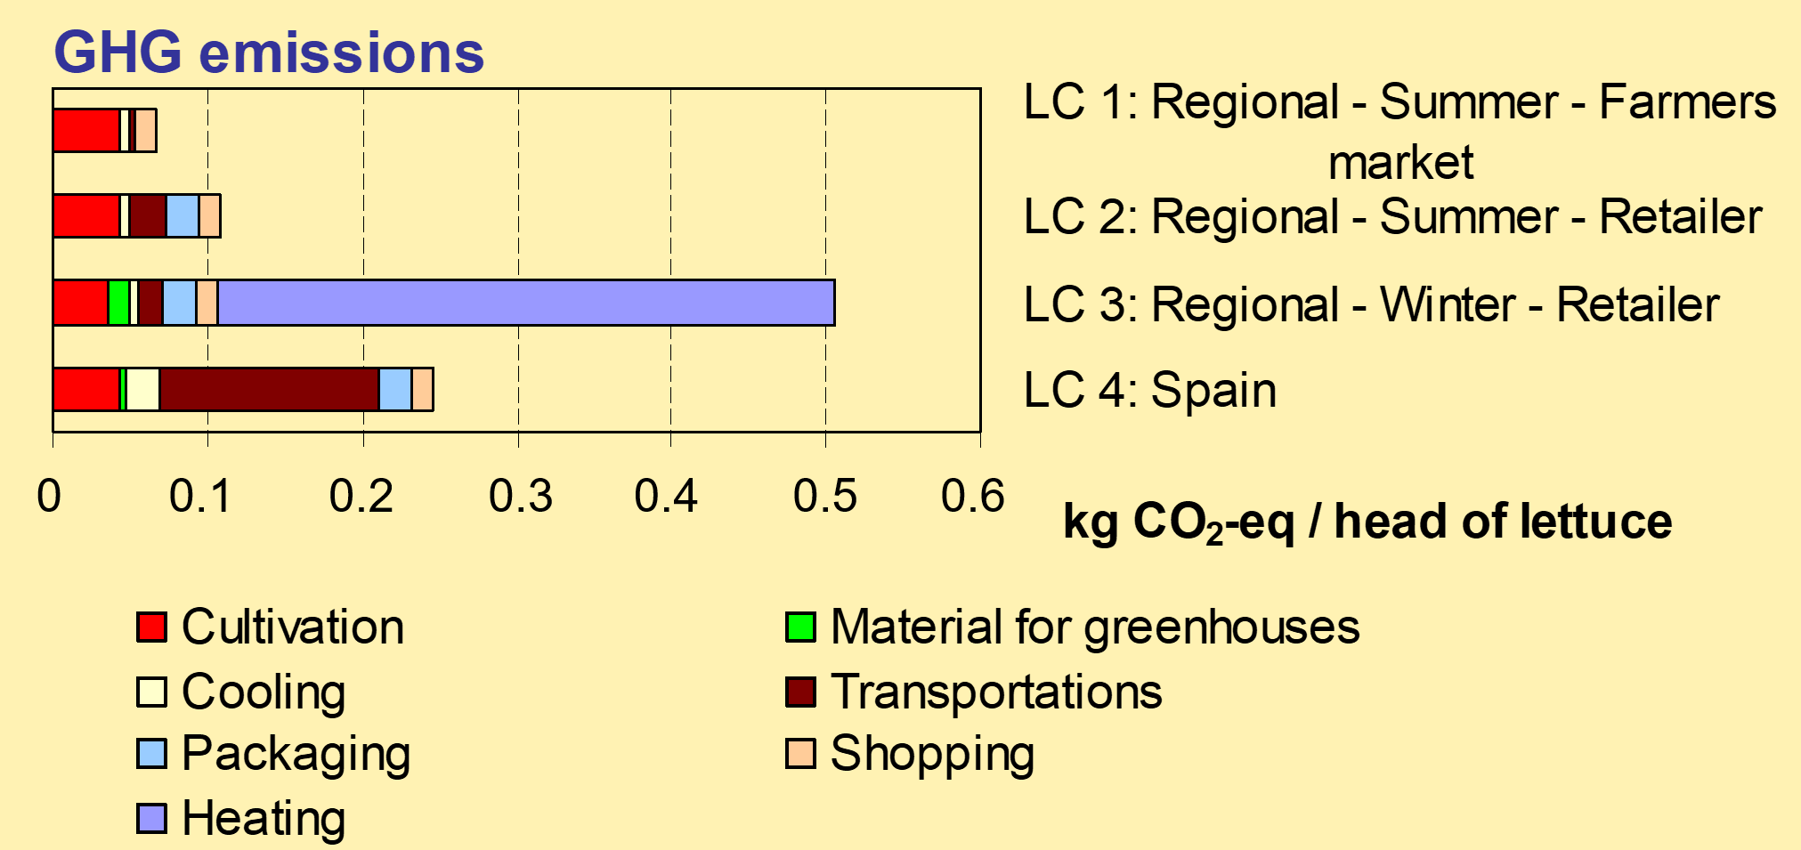
Lettuce: life cycle results

Slide 19
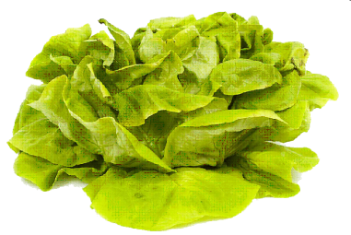

Conclusions: Apples and Lettuce
Regional and seasonal production is advantageous if production systems are similar
Regional but not seasonal products
Tend to be advantageous even if cooled storage over 6 month is needed
Tend to be disadvantageous if heating is needed
Recommendation: regional and seasonal

Slide 20
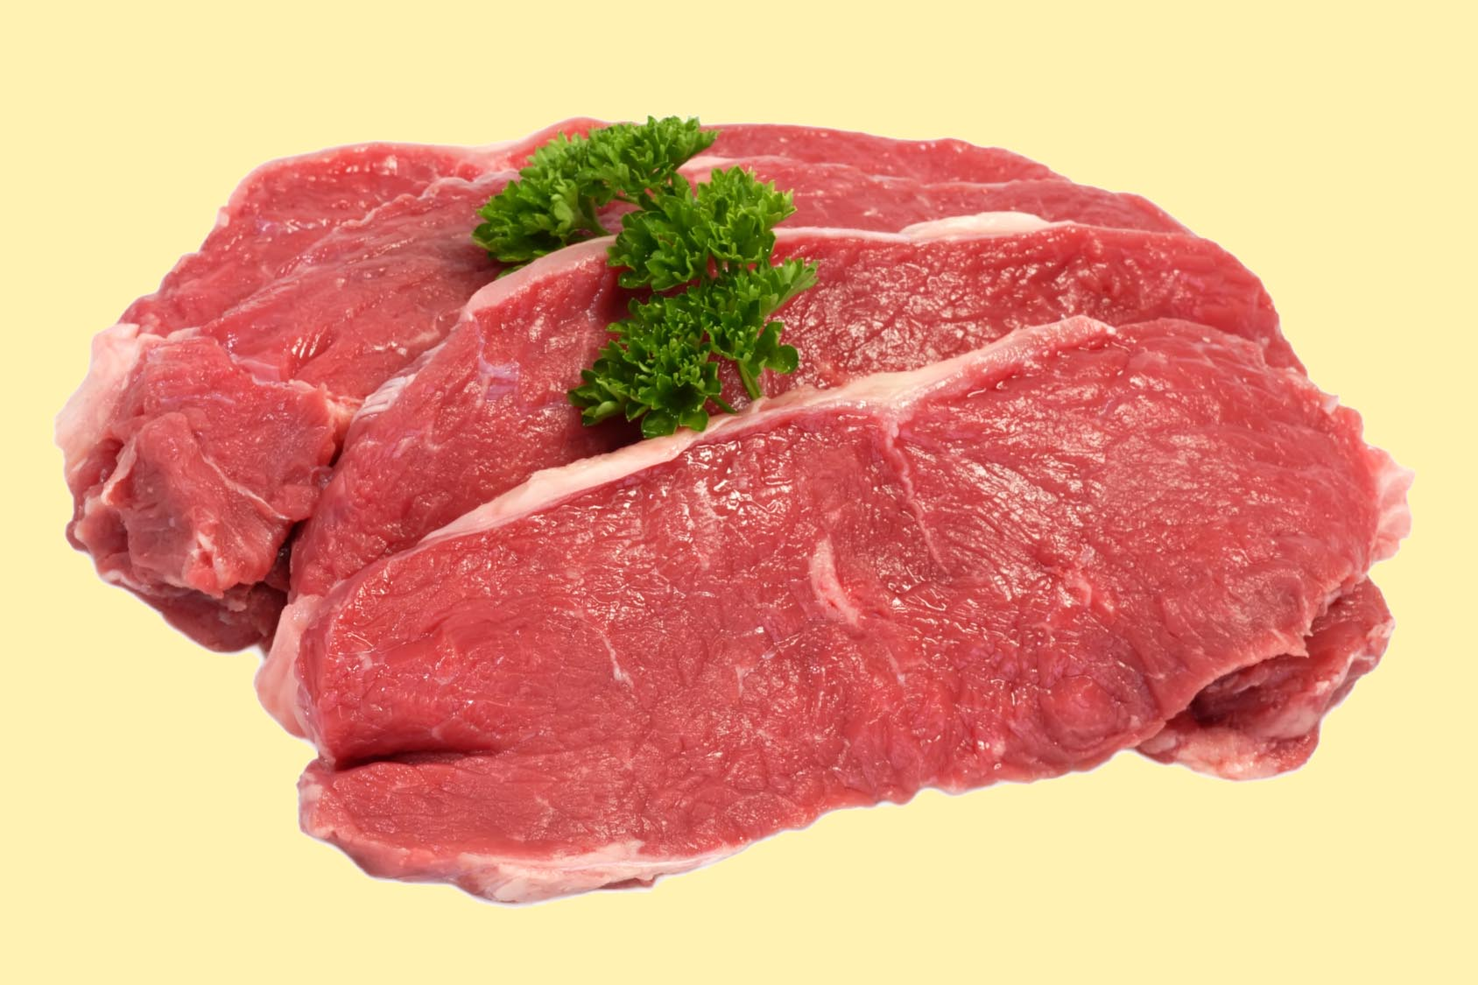
Beef
Bildchen

Slide 21
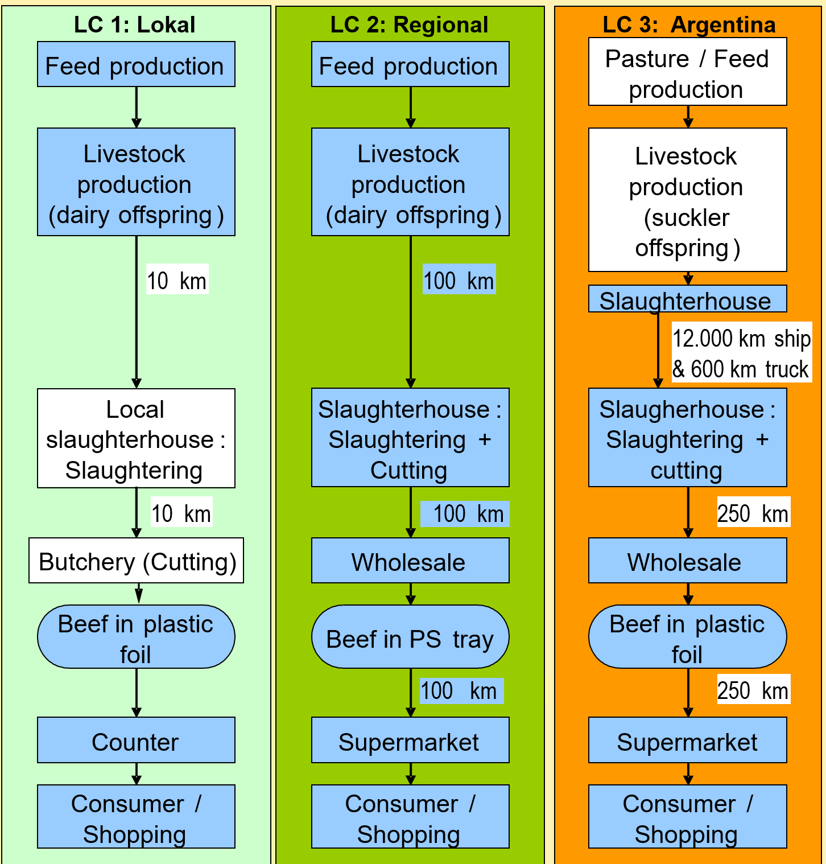
Beef: life cycle scenarios

Slide 22
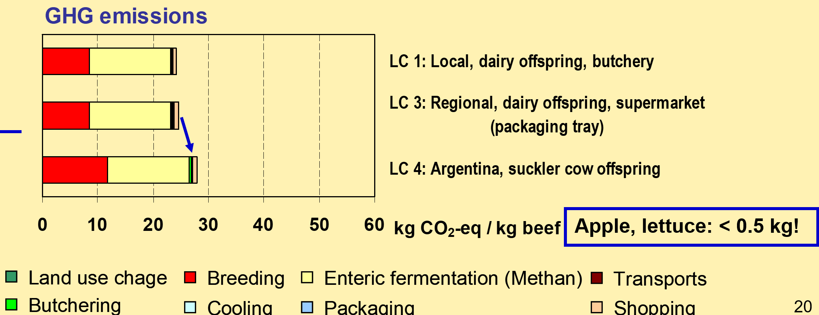


Beef: life cycle scenario results

Slide 23
Conclusions: beef
Regional production is advantageous with regard to GHG emissions
Advantages and disadvantages are more cause by differences in livestock production systems than by transport distances
GHG Emissions per kg of beef are about 20 times higher compared to GHG emissions per kg of apples or lettuce

Slide 24

Bread

Slide 25
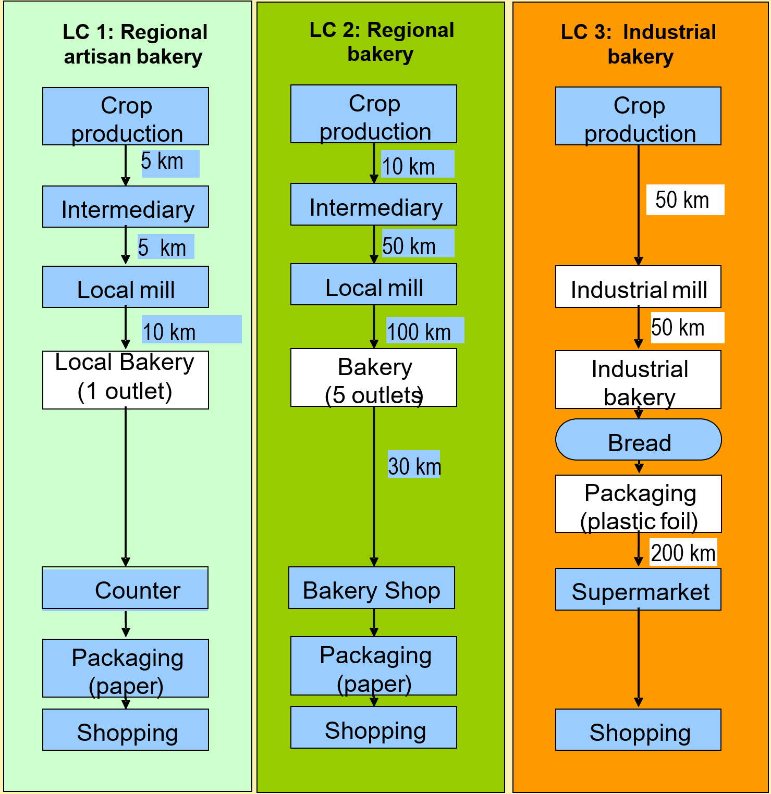
Bread: life cycle scenarios

Slide 26
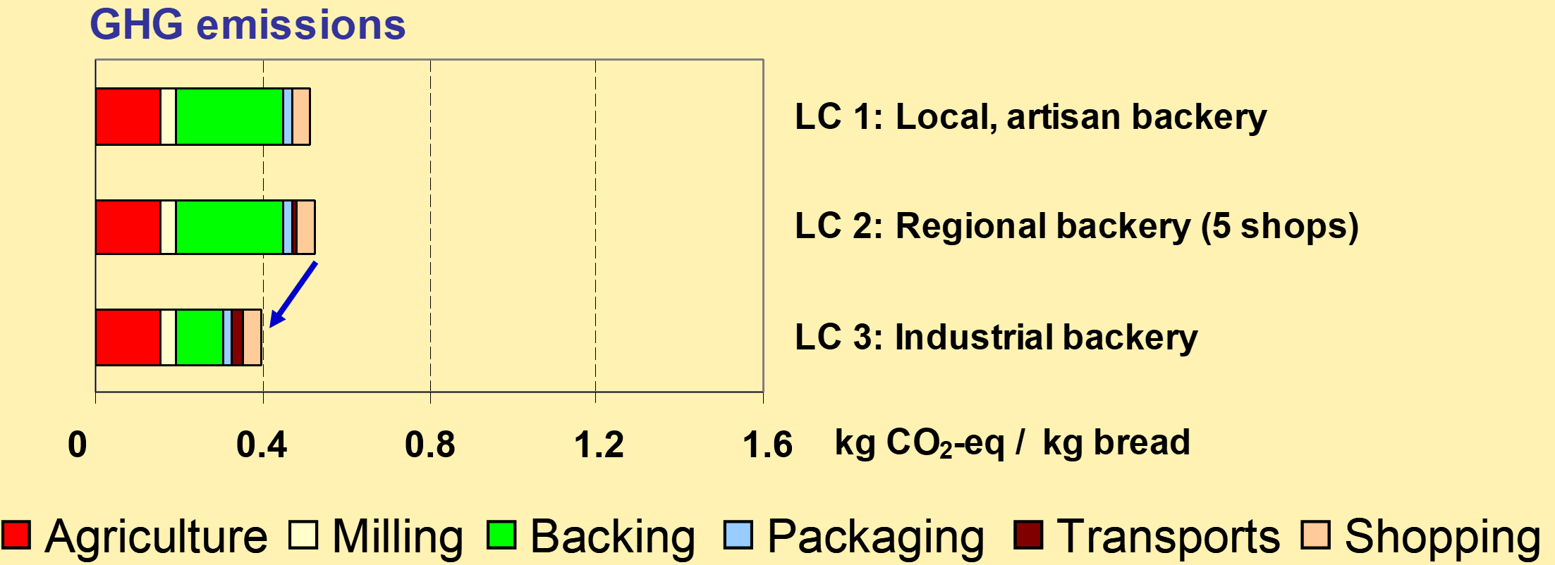


Bread: life cycle results

Slide 27
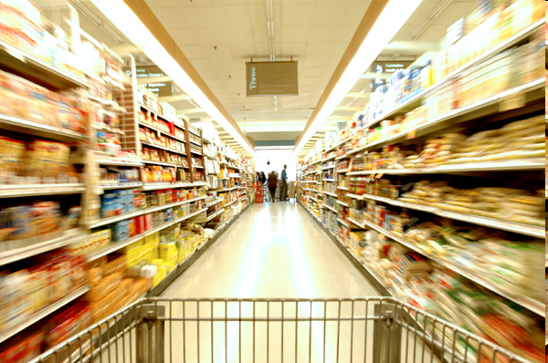
Consumer phase (shopping)
(Matty Symons © www.fotolia.de)

Slide 28
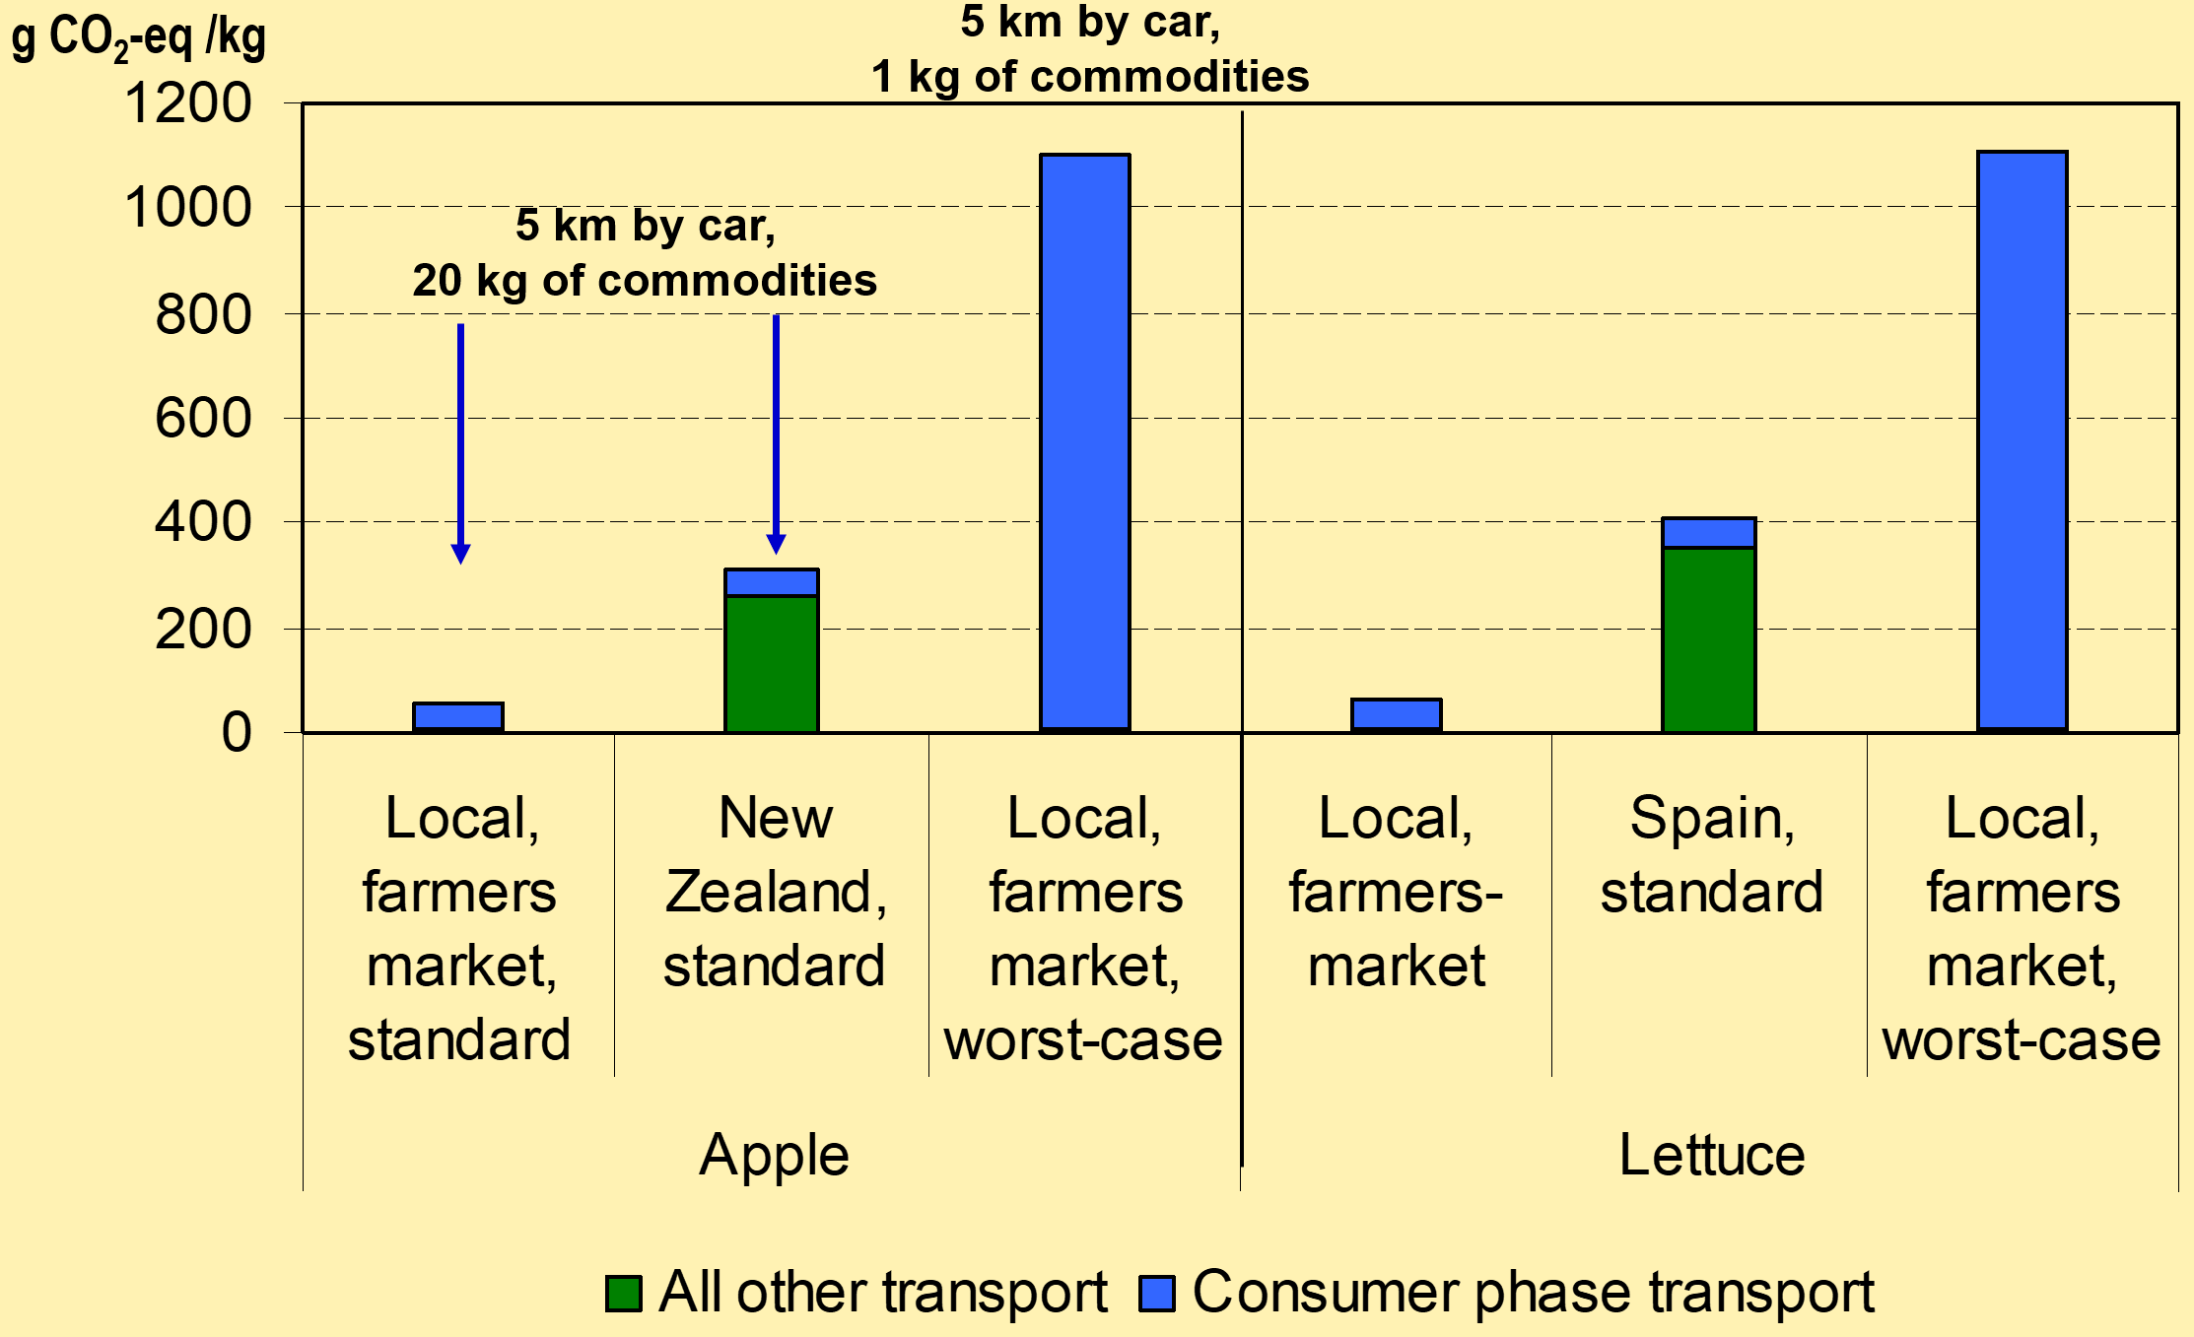
GHG emissions from shopping

Slide 29
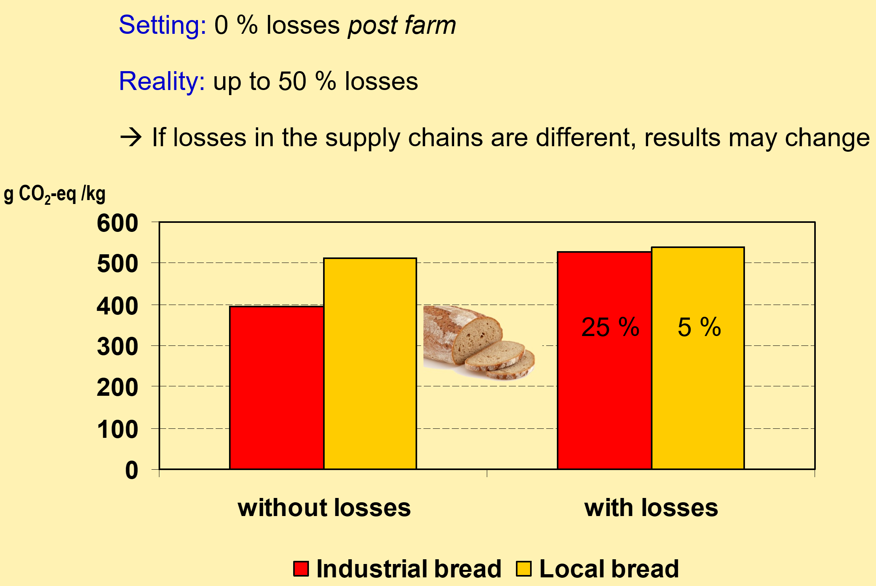
Supply chain losses

Slide 30
Packaging
MJ PE / l

Slide 31
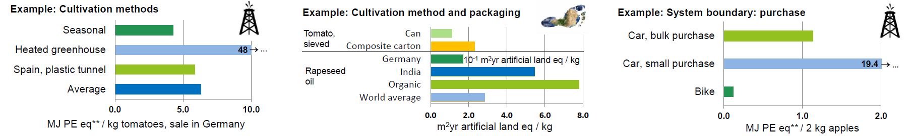
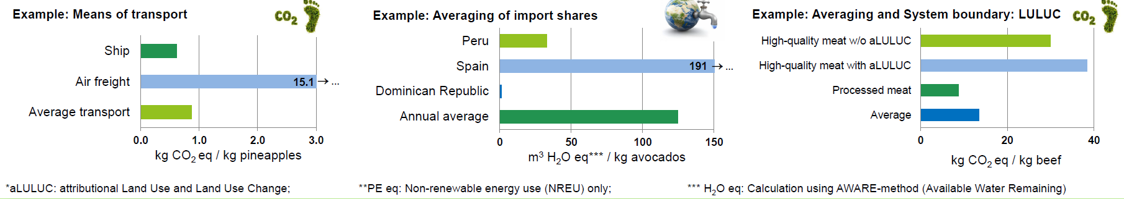
Six reasons for the variation in food LCAs

Slide 32
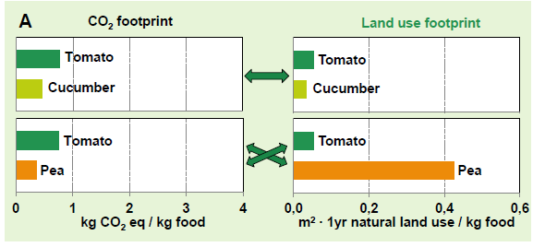
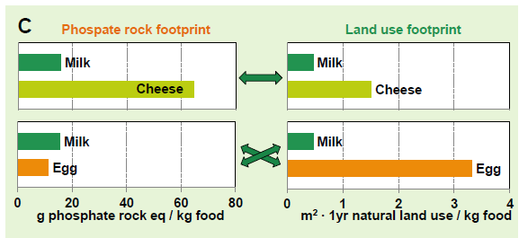
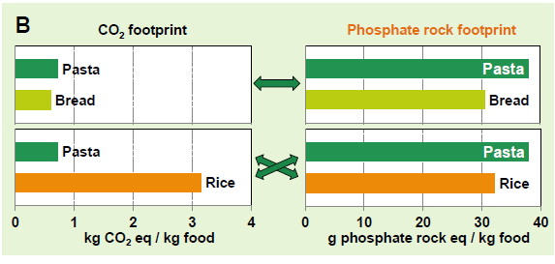
CO₂, land use and phosphate rock footprints
The land use and phosphate rock footprints can be quite different to the CO2 footprint of a food product.

Slide 33
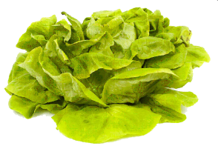

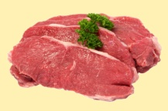

Conclusions (1)
Regional production is advantageous if the productions systems are the same.
If production systems differ:
For vegetables and fruits:
Non-seasonal vegetables are most likely disadvantageous if heating is needed.
Non-seasonal vegetables/fruits can still be advantageous is only cooled storage is needed.
For beef:
No recommendation (depending on production system, opposing effects on energy and climate)
Much higher GHG emission compared to vegetables/fruits (about 20 times per kg)
For bread:
Industrial bakery more energy efficient. But: Only for low consumer transport distances.

Slide 34
Conclusions (2)
If regional production is advantageous or not depends on the production system
Regional processing is often small-scale processing and can be less energy efficient
Productions system for some products can be very different in different regions
Seasonality: Regional, non-storable products are advantageous only as seasonal products
Cooled storage can be more efficient than intercontinental supply of fresh commodities

Slide 35
Conclusions (3)
Recommendations to consumers
Regional + seasonal
Don’t go shopping by car (or don’t drive extra kilometers)
Buy only what you can eat
Recommendation to retailers
Regional + seasonal ingredients
Optimization of food supply chain: Minimum losses
Optimization of processing (energy efficiency)
Analysis of specific production chains may be necessary

Slide 36
Limitations
Results relate to GHG emissions only
Other environmental effects not regarded, such as
Impact on biodiversity
Eutrophication and acidification
Water use (addressing scarcity)
Land use
Phosphate use
Social implications not regarded

Slide 37
Group work (4 groups @ 4-5 persons)
Group work (20 minutes)
Select a question related to LCA of food in your geographical area
Define the scope of the LCA
Define system boundary
Define life-cycle steps
Describe the necessary data collection
Report back of group work (10 minutes)

Slide 38
Part 2: Tools and Databases
LCA Tools
Open LCA
Commercial tools (Gabi, SimaPro, Umberto etc.)
Databases for food LCA
FAO Stat
World Resources Institute (WRI)
Bilan Carbone (French)
Integrated Urban Planning with the Rapid Planning Simulator
Tools for GHG balances of hospitals
Healthcare Without Harm: Climate Impact Checkup Tool
Ecocockpit GHG balance of the Heidelberg University Hospital

Slide 39
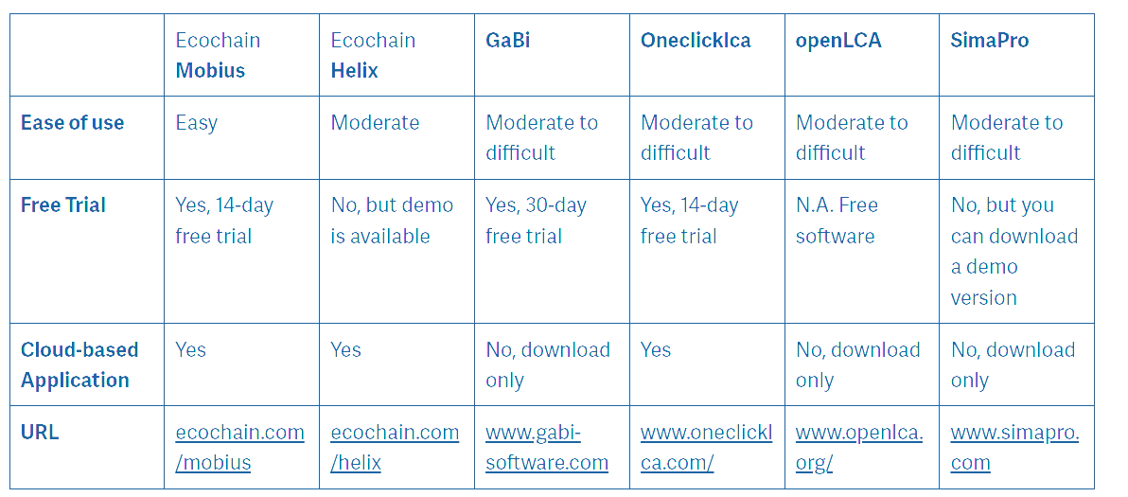
LCA Software

Slide 40
Databases
● ecoinvent – 11,000 data sets, focus on Europe, very consistent, well documented, subject to a fee.www.ecoinvent.org
● GaBi Databases – 7,000 data records from Thinkstep (formerly: PE international), subject to a fee with a few exceptions http://www.gabi-software.com/deutsch/databases/
● ProBas (German) – 8,000 data records of different quality, focus on energy, materials & products, transport, disposal, German Federal Environment Agency, free of charge. www.probas.umweltbundesamt.de
● NREL – Focus US, free. www.lcacommons.gov/nrel
● Many other mostly thematically specialized databases (BioEnergieDat, ÖkoBauDat, NEEDS, LCAFood, ...) Some of them listed here: https://nexus.openlca.org/databases

Slide 41
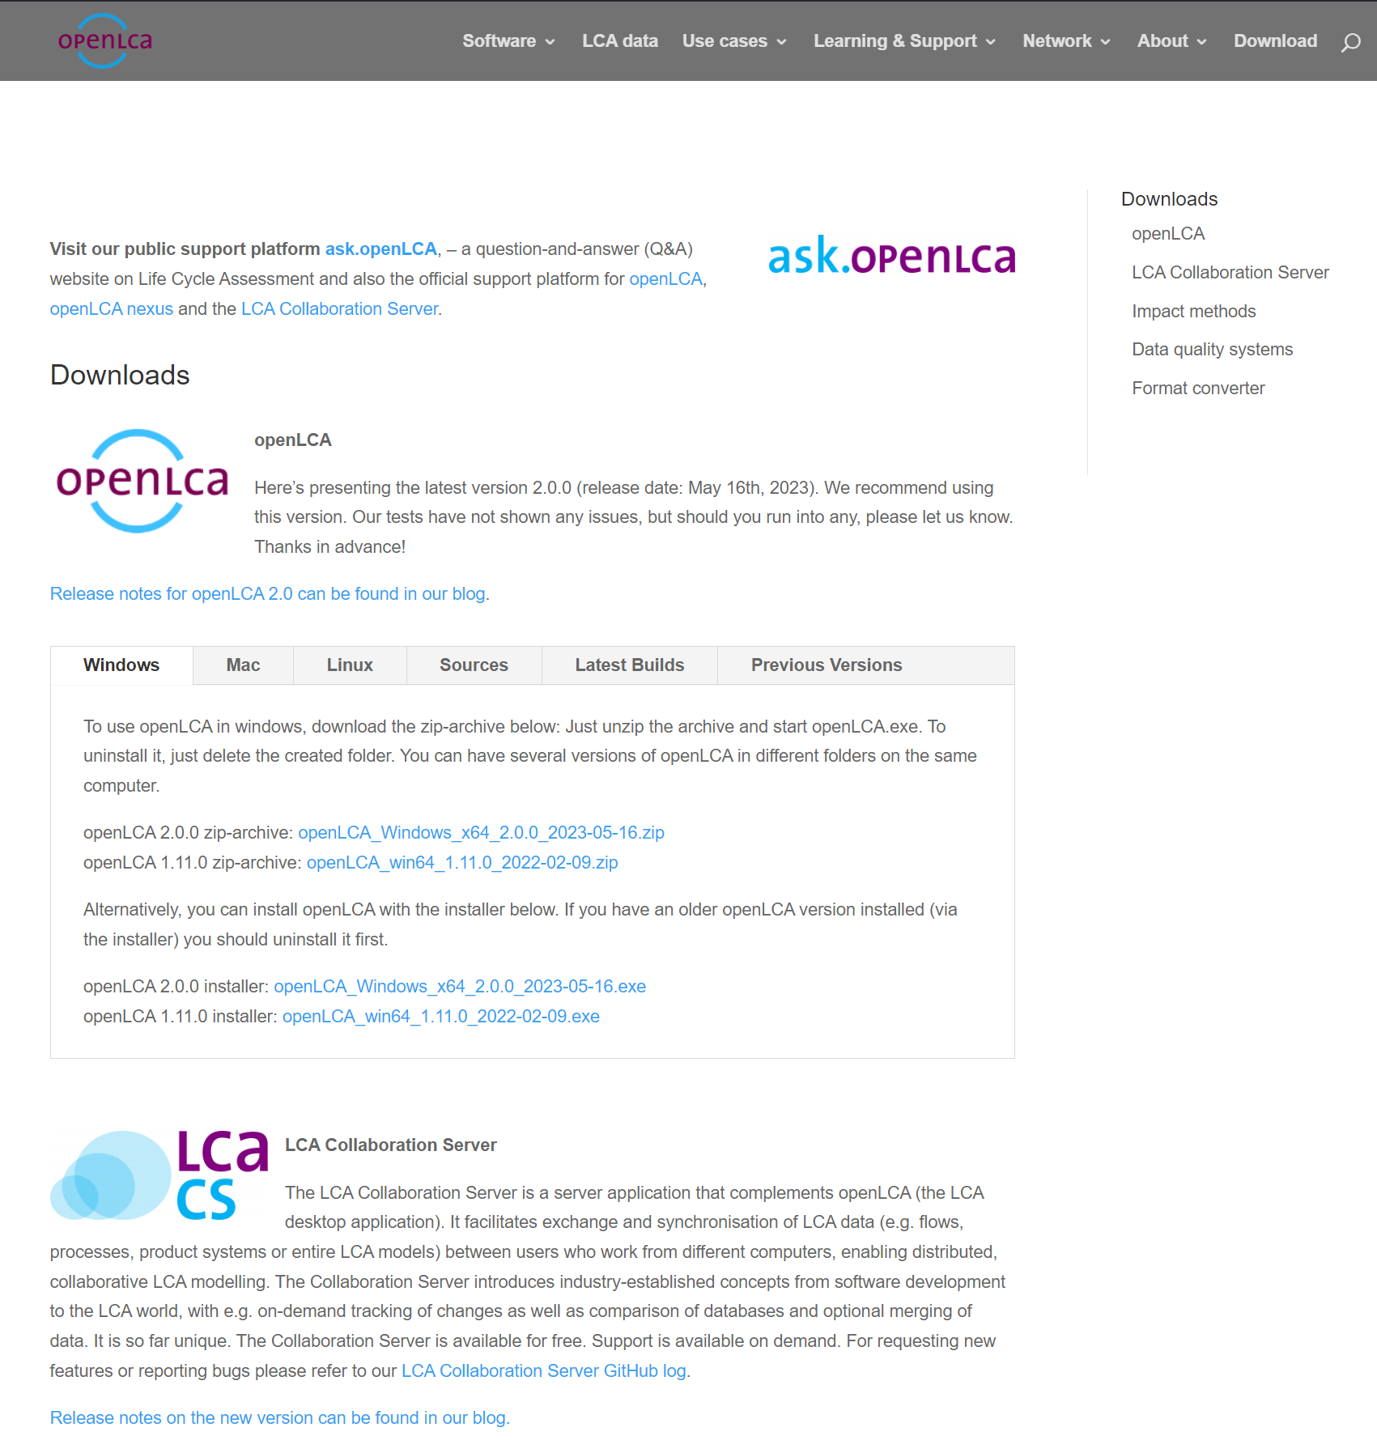
Open LCA https://www.openlca.org/

Slide 42
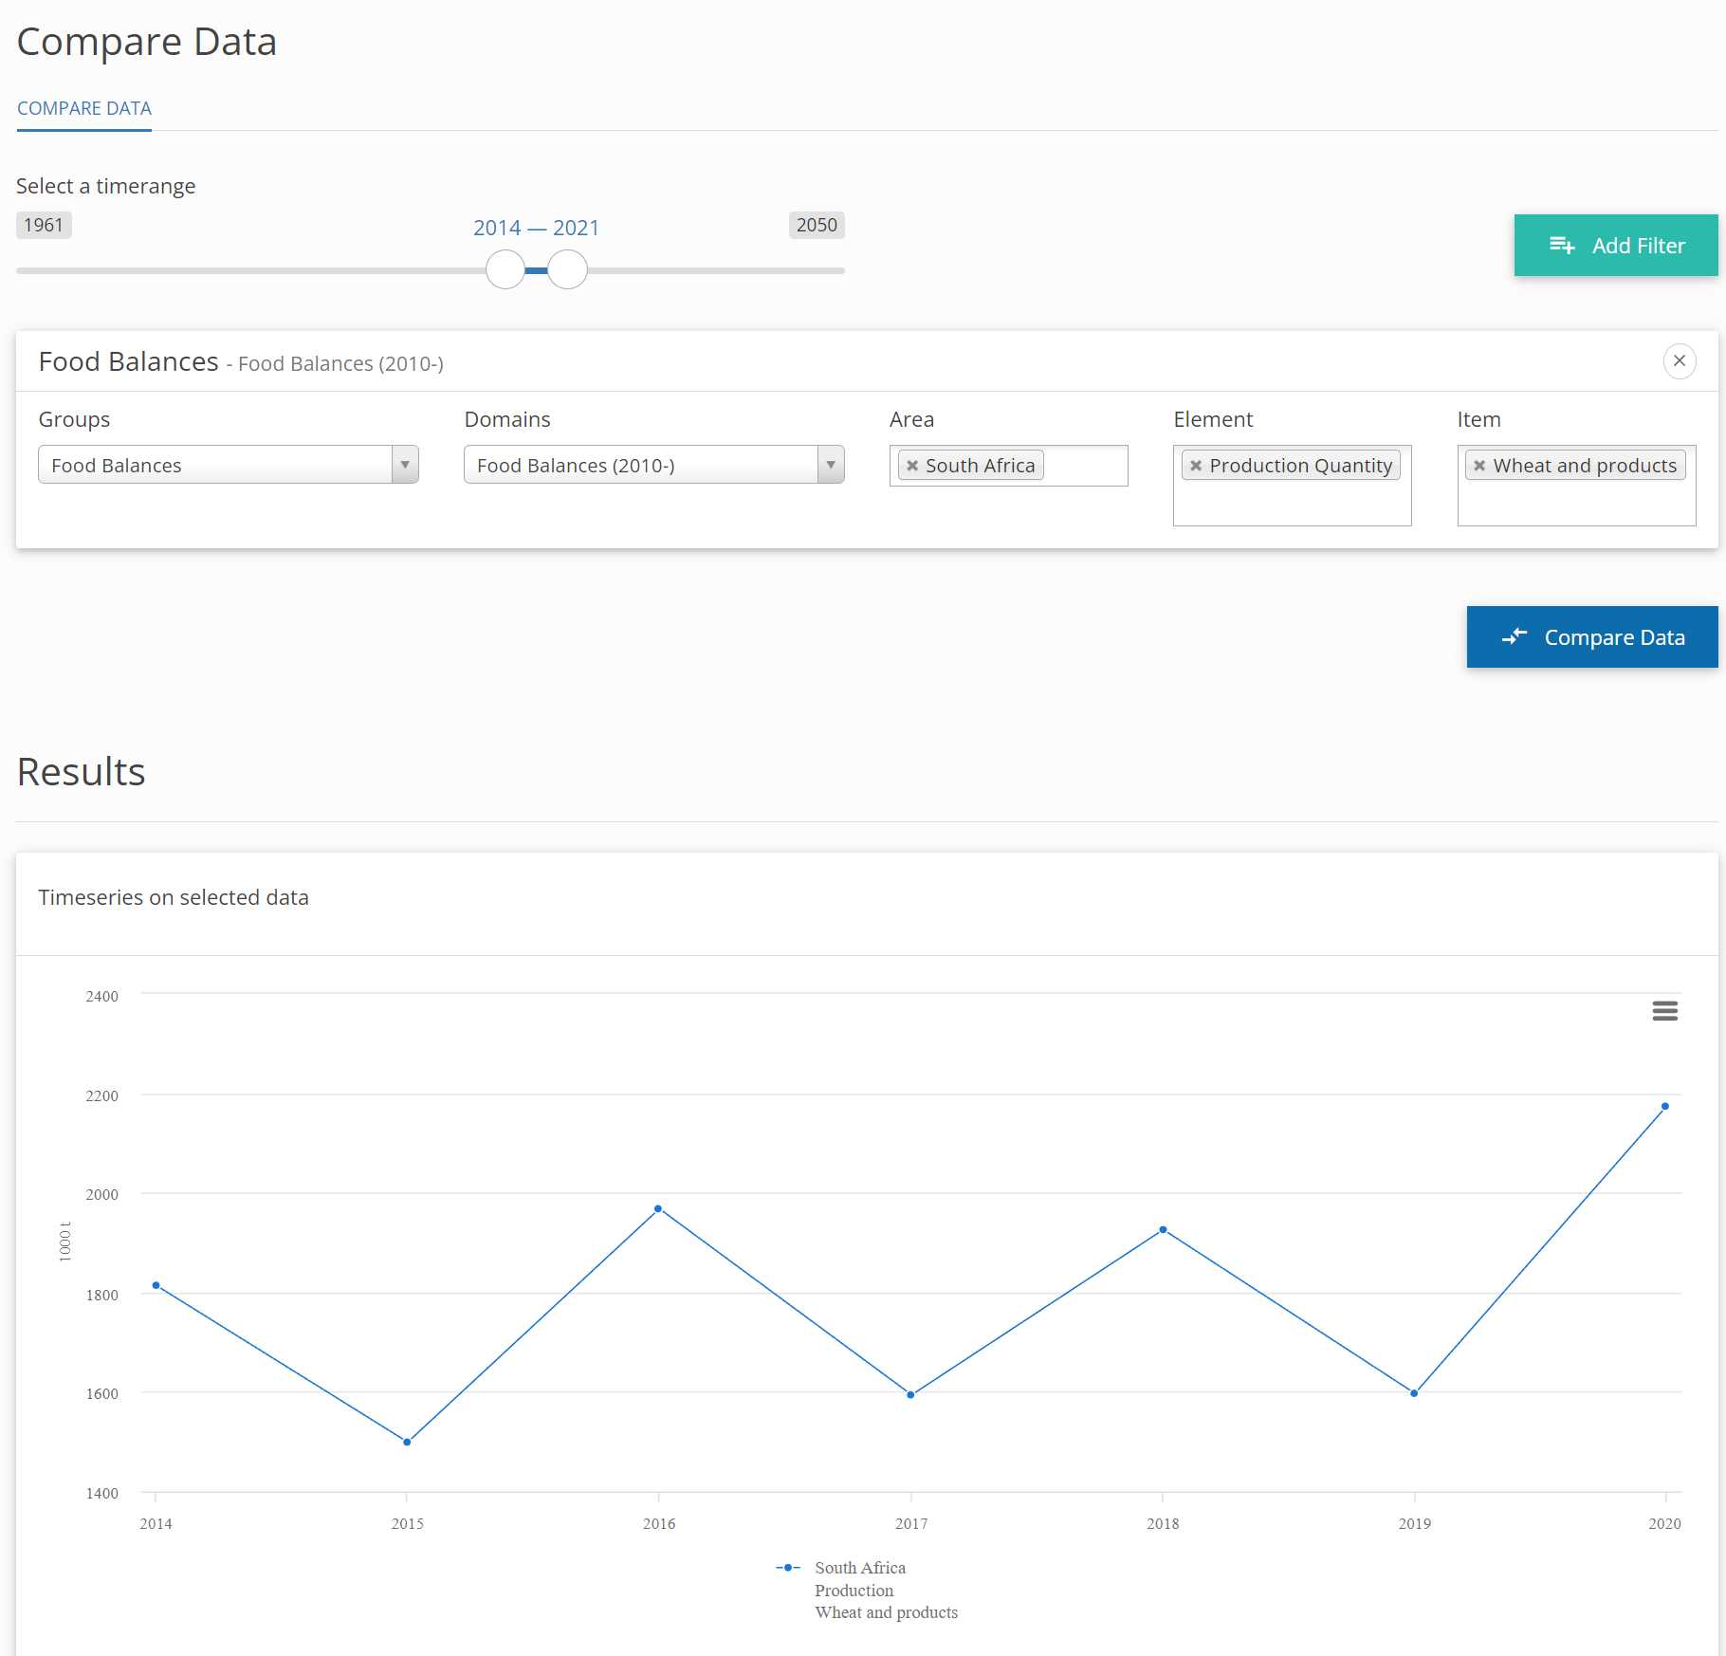
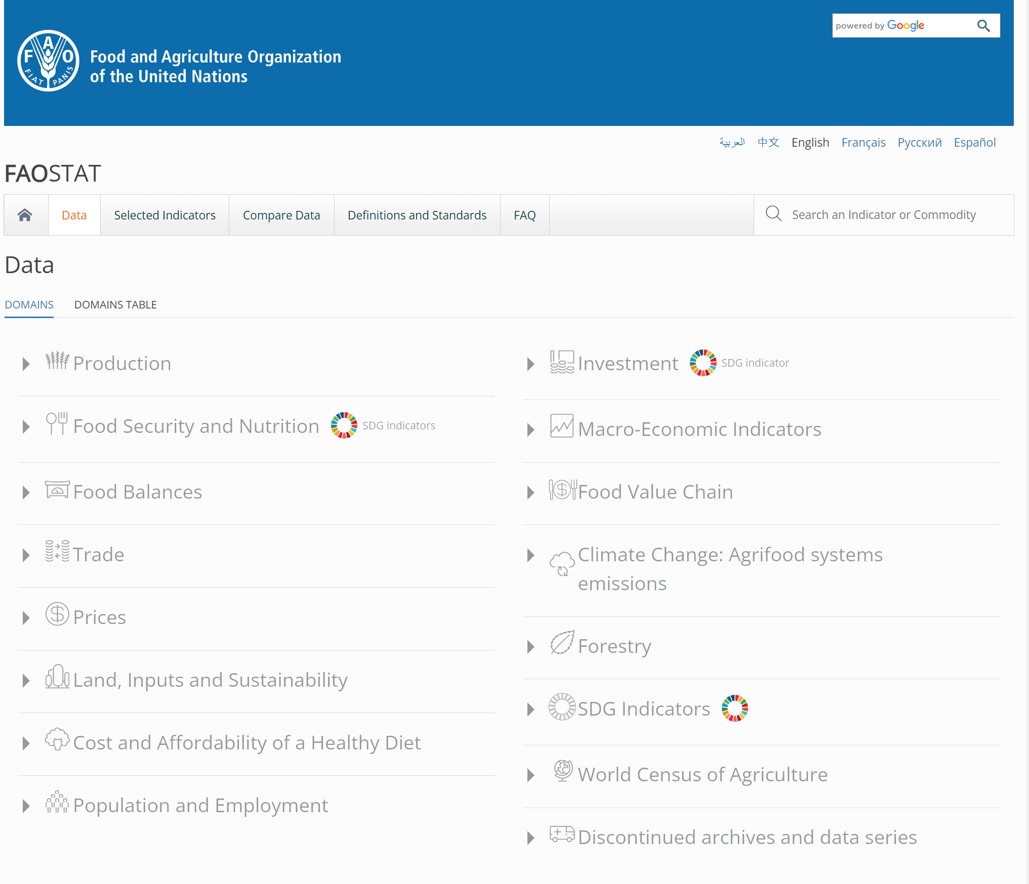
FAO Stat https://www.fao.org/faostat/en/#compare

Slide 43
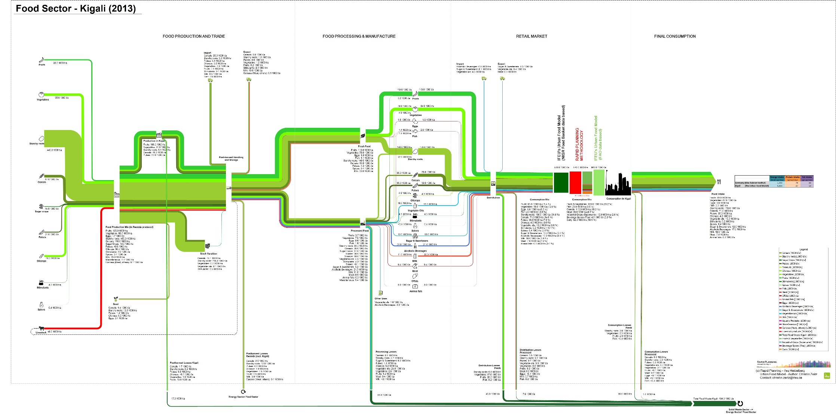
FAO Stat

Slide 44
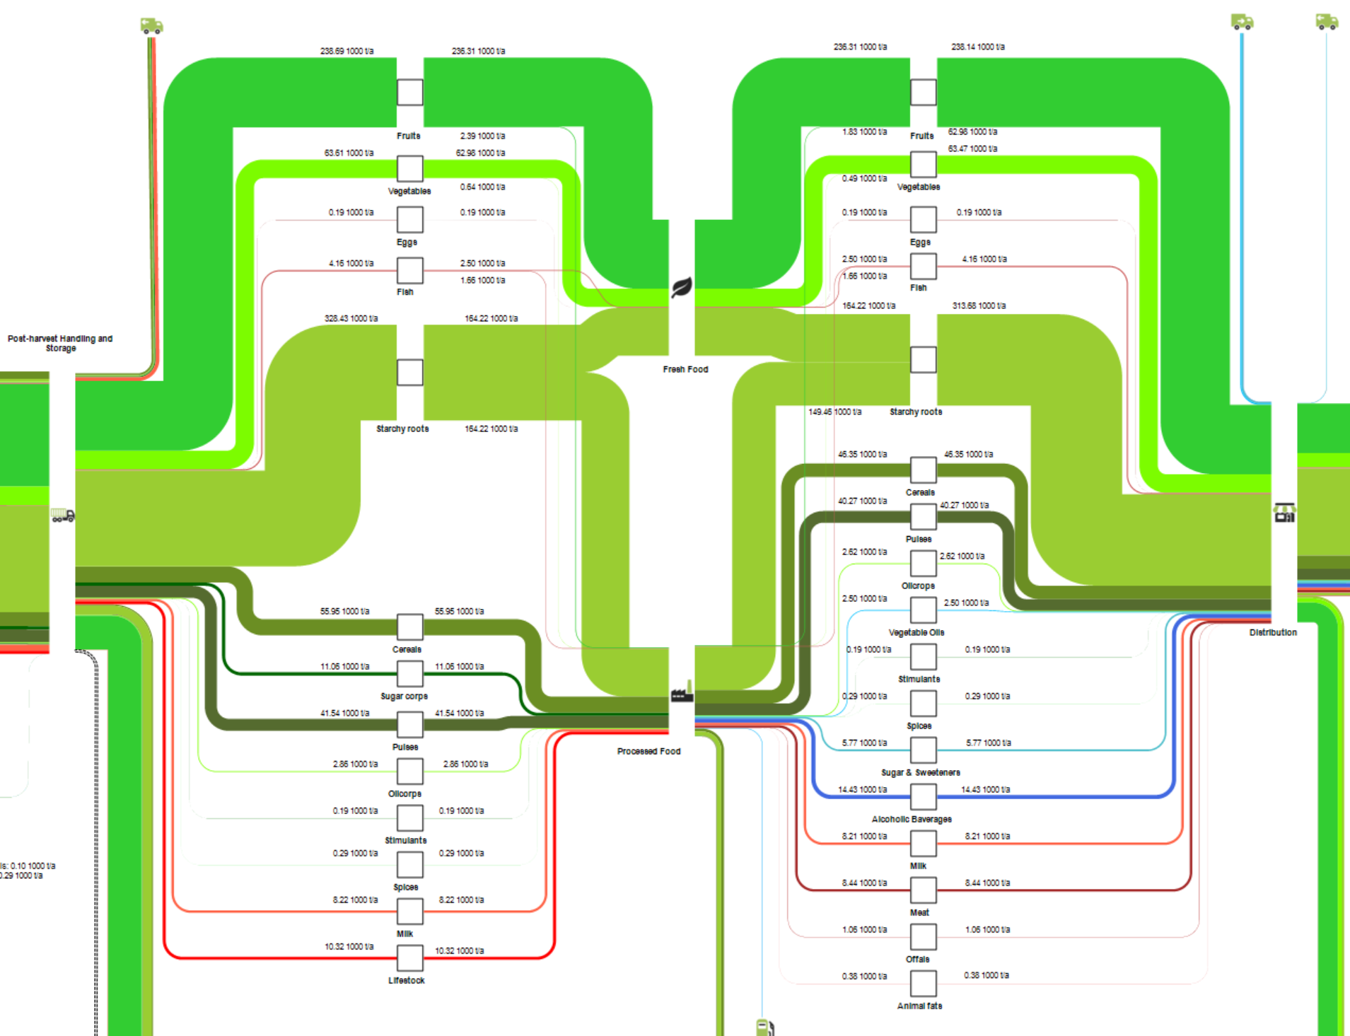
FAO Stat

Slide 45
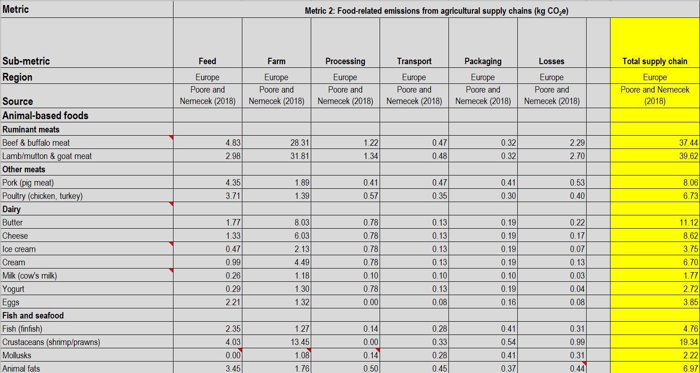

World Resources Institute (WRI) - https://www.wri.org/food
World Resources Institute (WRI)

Slide 46
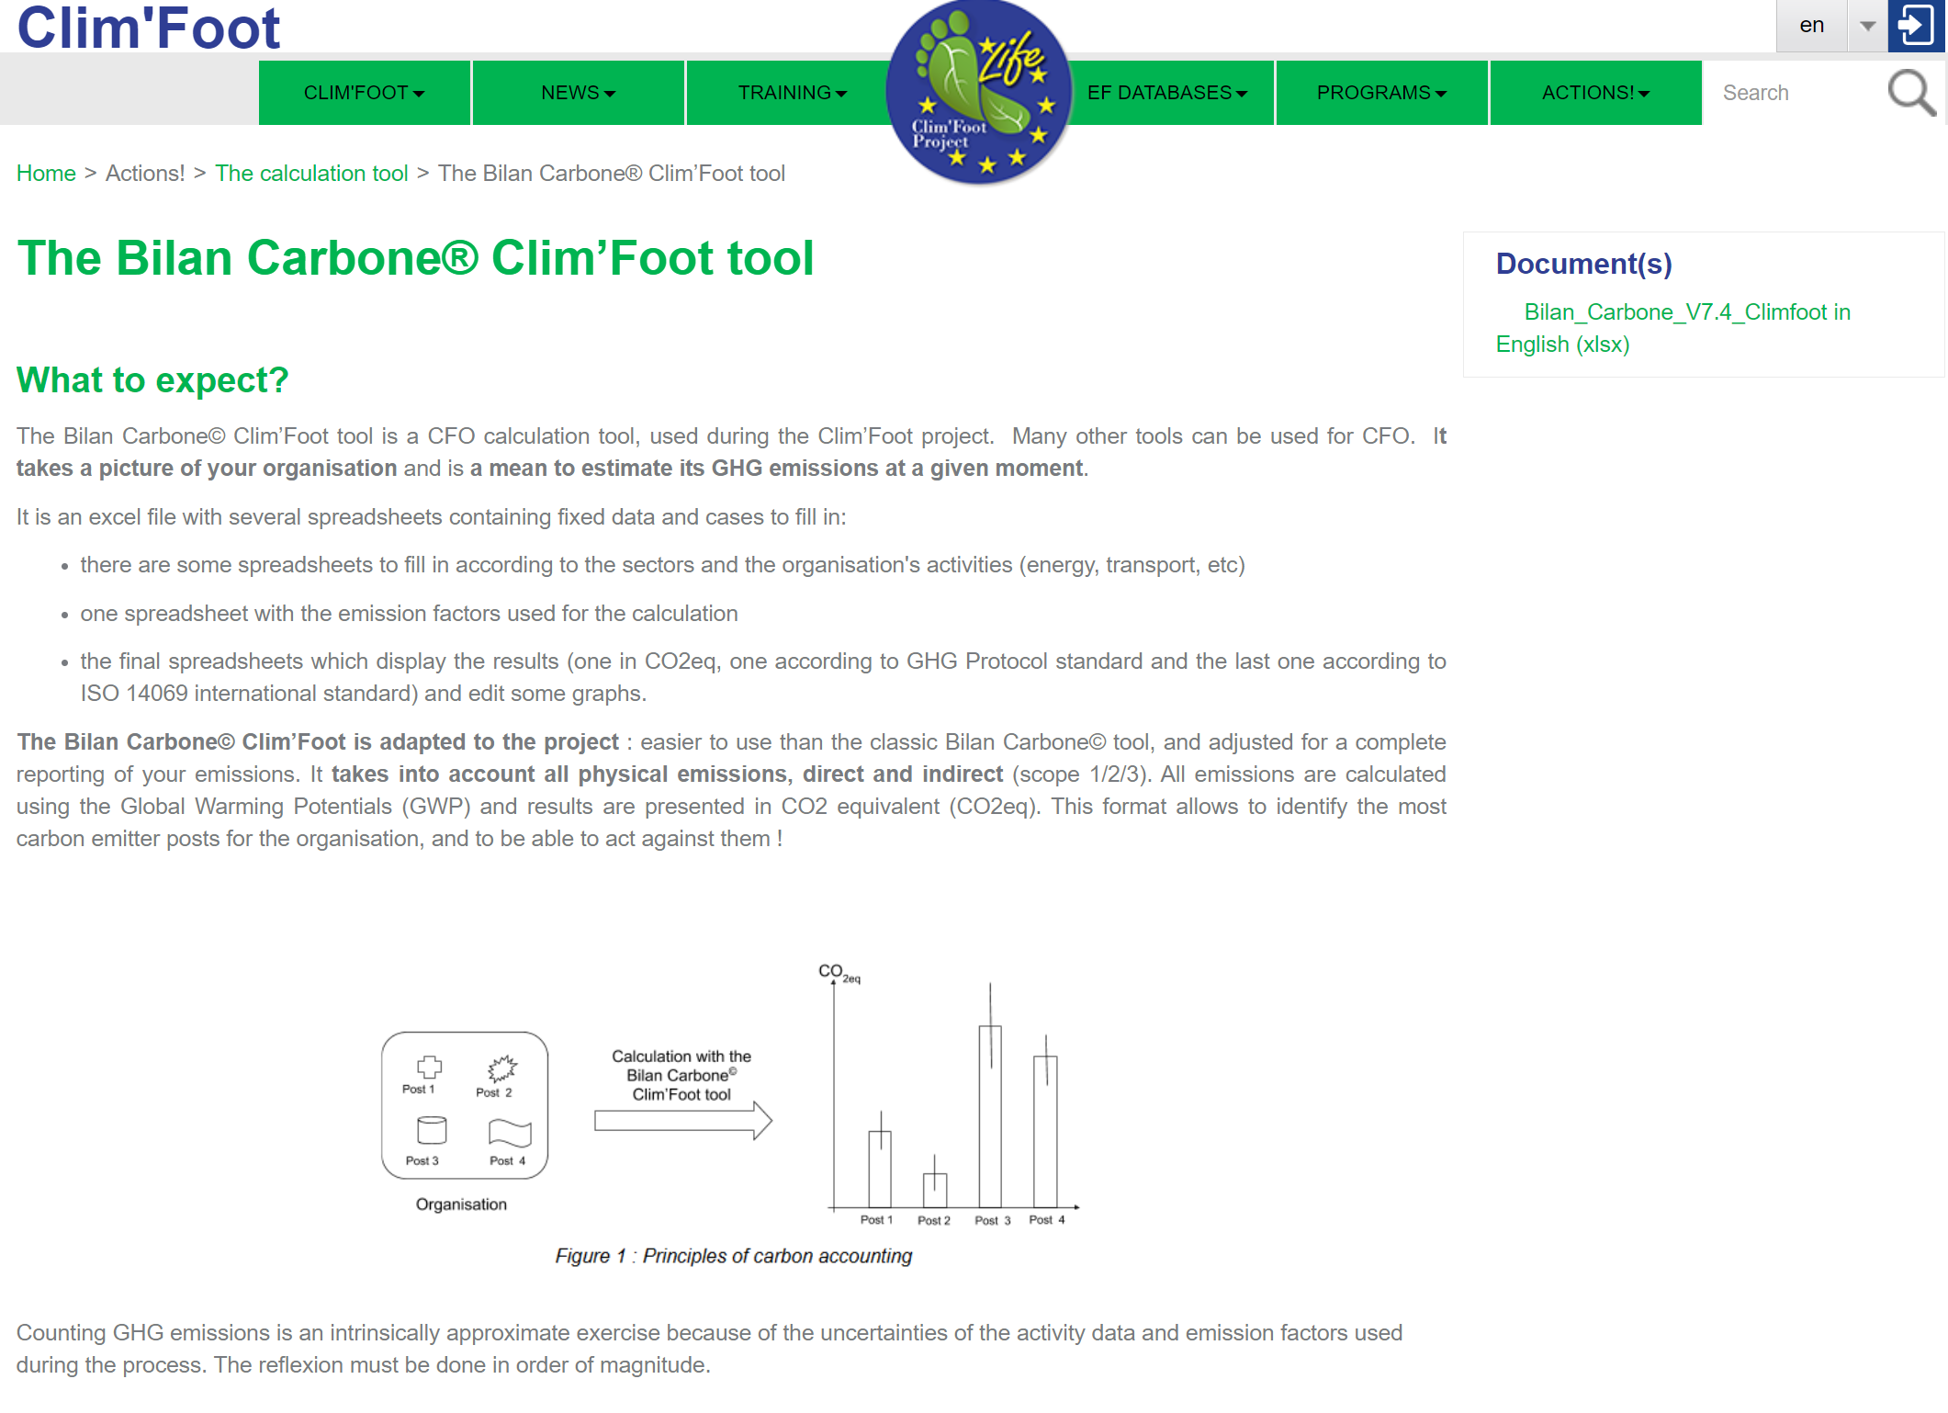
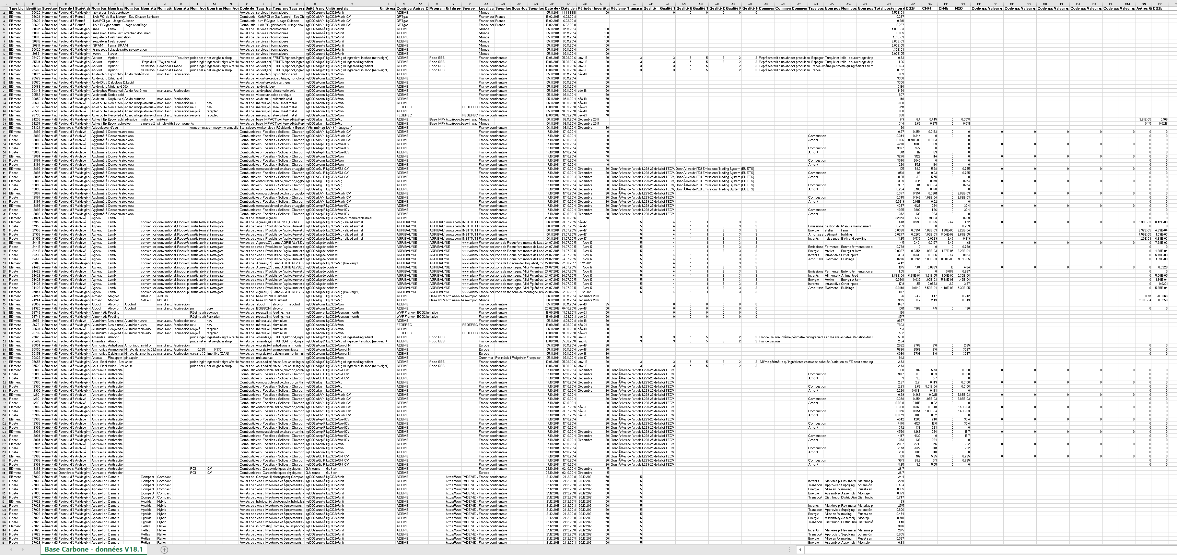
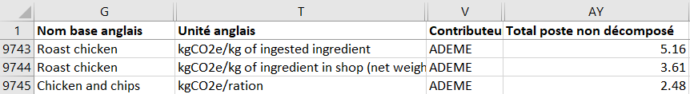
Bilan Carbone https://www.climfoot-project.eu/en/bilan-carbone%C2%AE-clim%E2%80%99foot-tool
Tool
Database (Excel spreadsheet)
14080 lines, 67 columns

Slide 47



Duration: 2014-2019 Funding: German Ministry of Education and Research BMBF Partner cities: Kigali Danang/Vietnam Assiut/Egypt

Slide 48
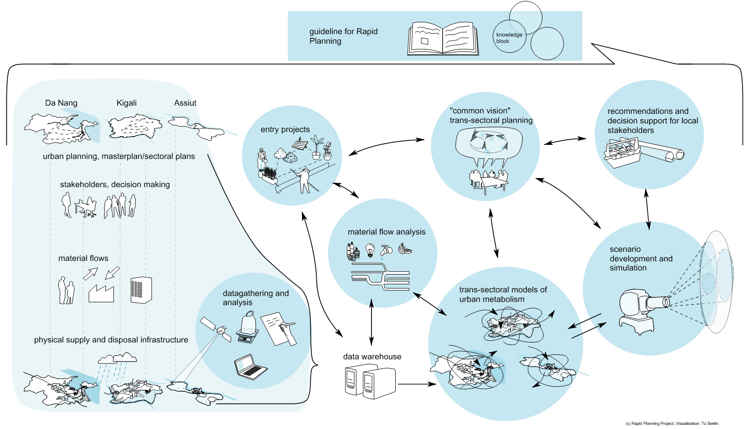
Rapid Planning - Overview

Slide 49
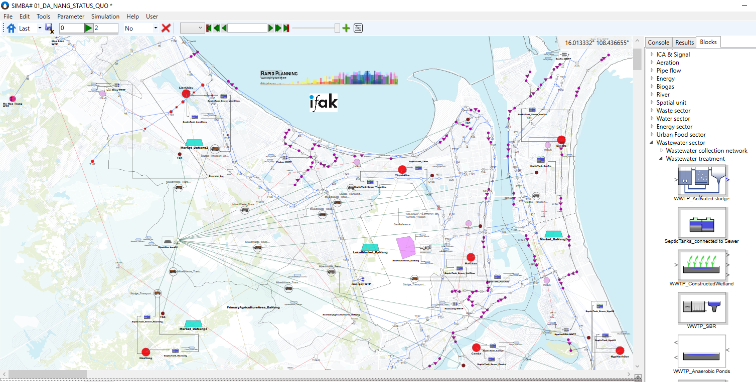
Rapid Planning - Scenario simulation
Rapid Planning provides …
Information by satellite images
Socio-economic data
Data and information on sectoral infrastructure
culminate into
Rapid Planning Simulator
Specific planning values
Scenario definition
Visions and ideas, inspired also by “Entry projects”
supports
Scenario definition
Stakeholder involvement, planning processes
System understanding
Capacity building

Slide 50
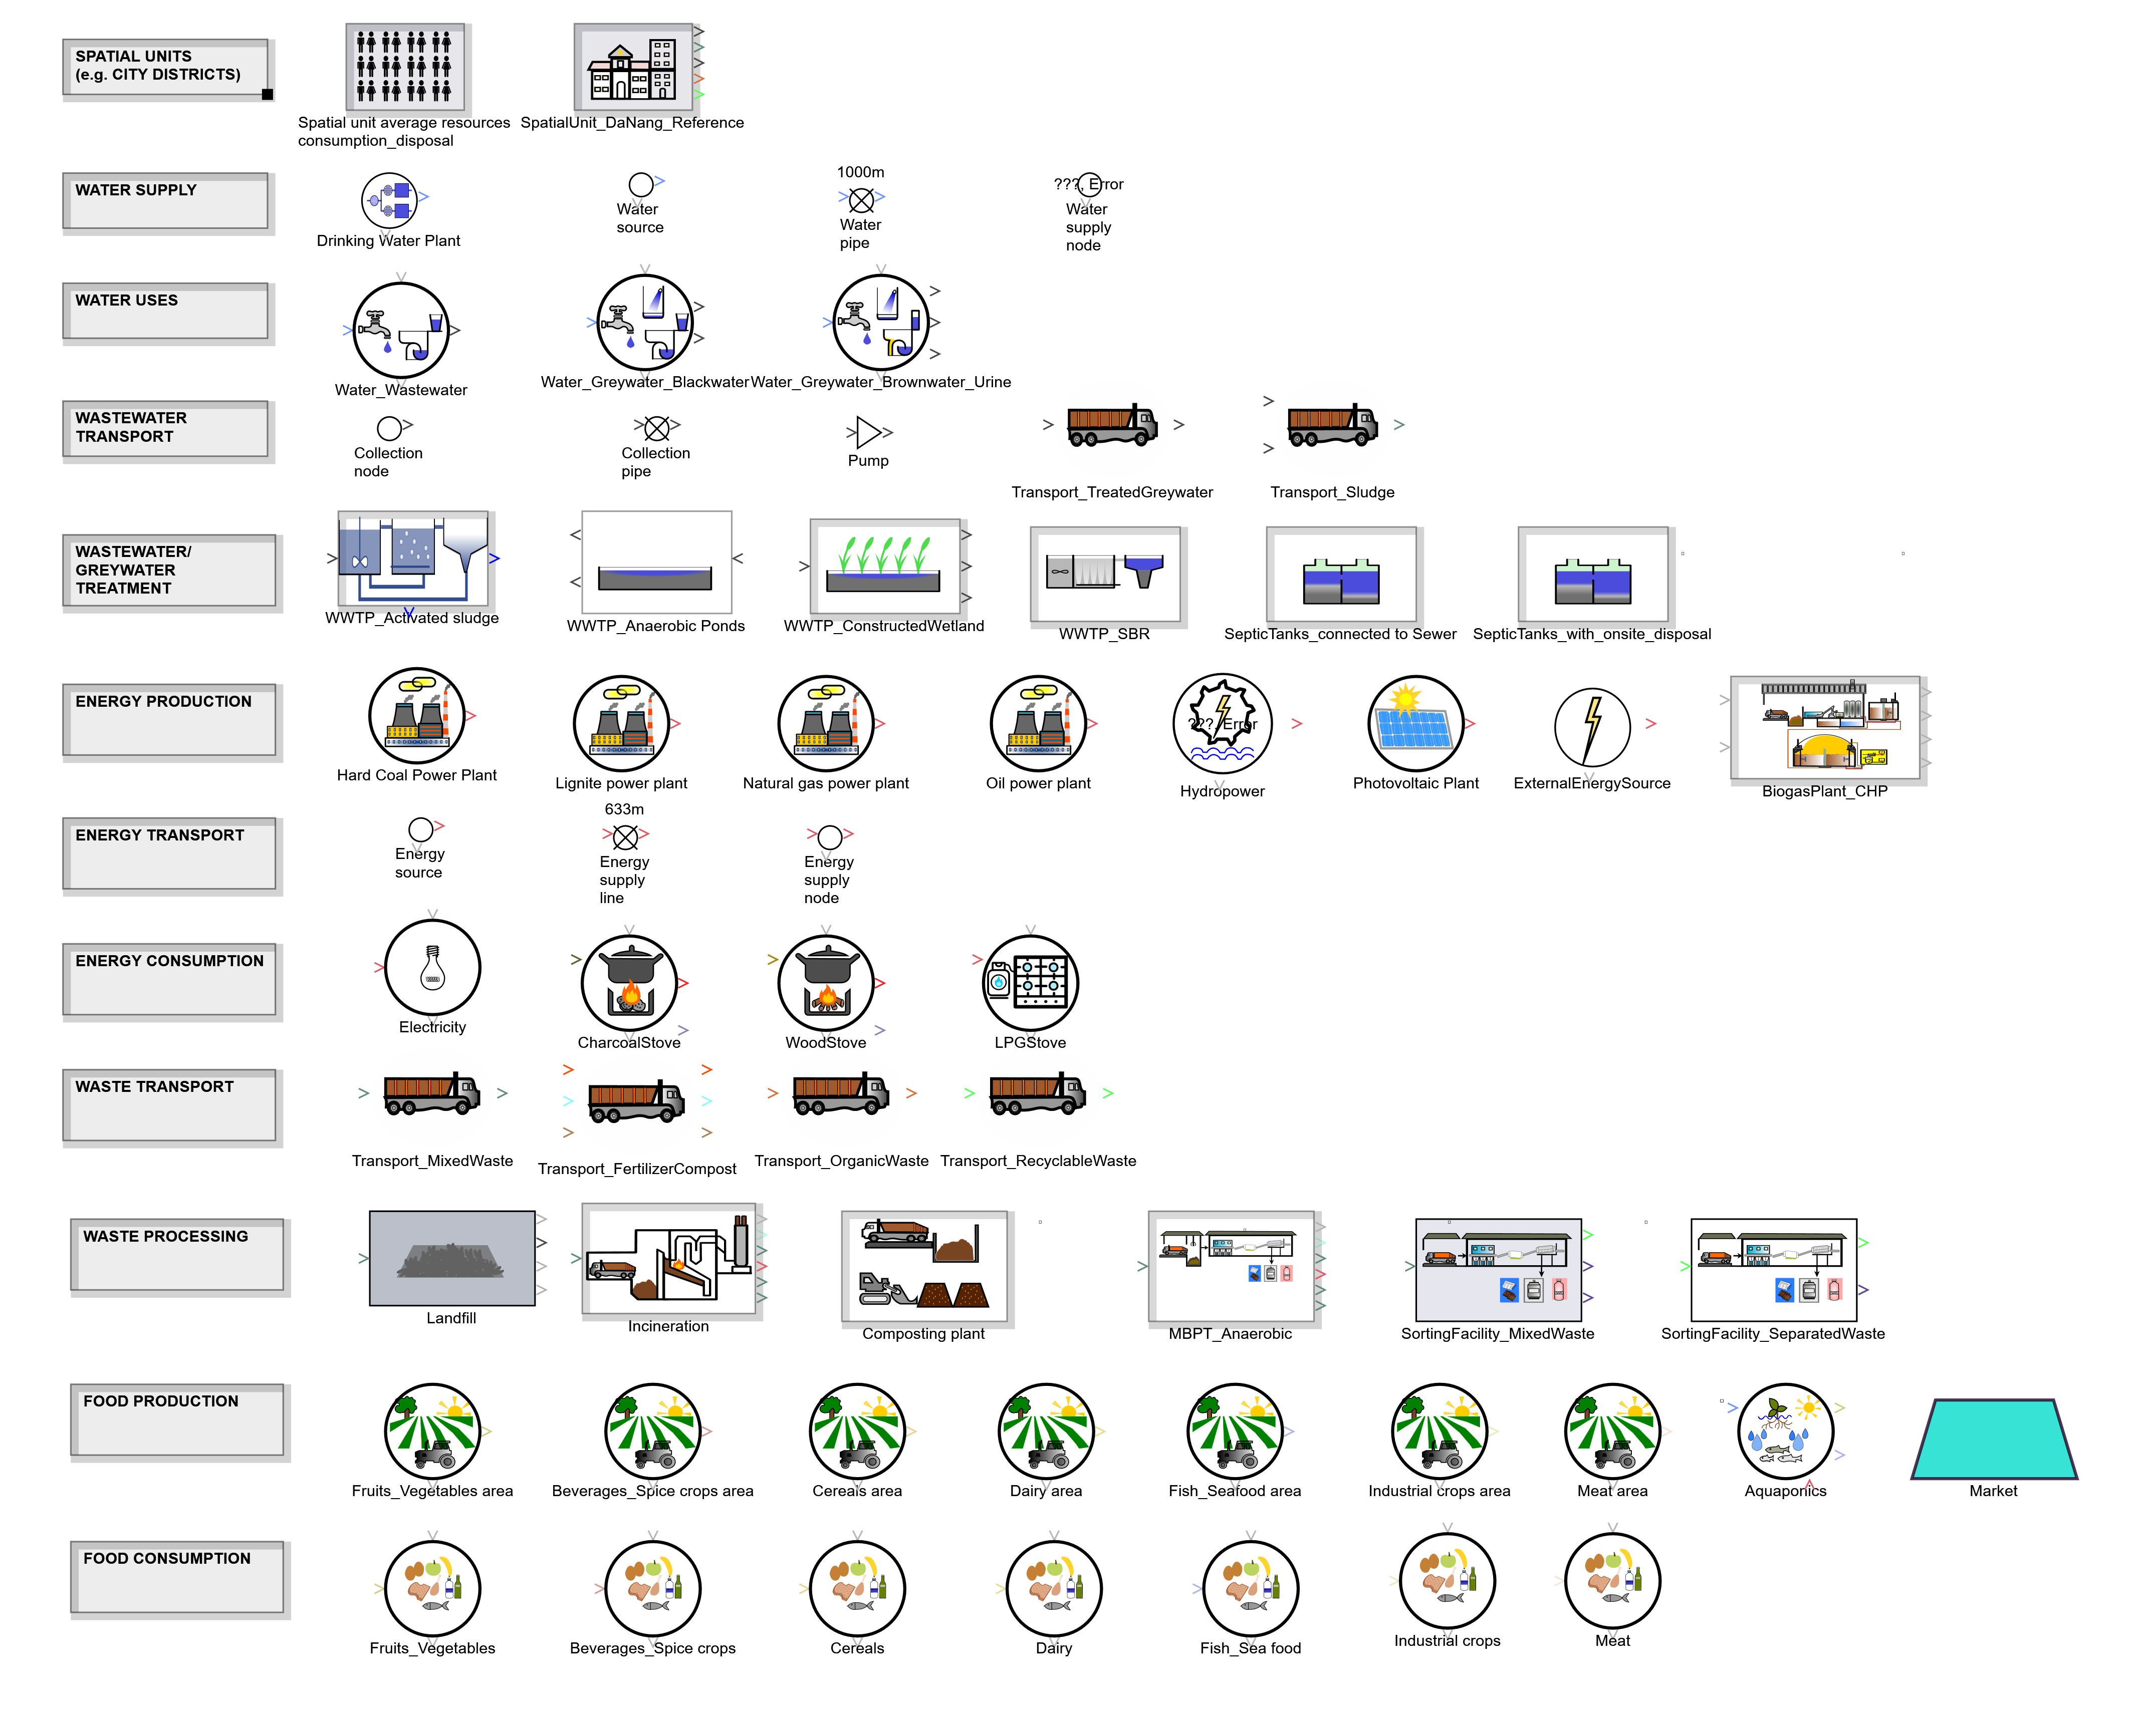





Rapid Planning – build a model of your city
Spatial Units
(e.g. City districts)
Extract of RP-Simulator block library
Water
Wastewater
Energy
Waste
Food/Agriculture

Slide 51
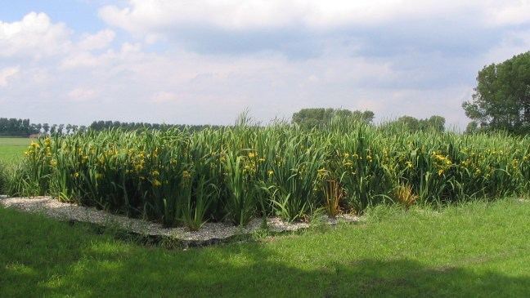

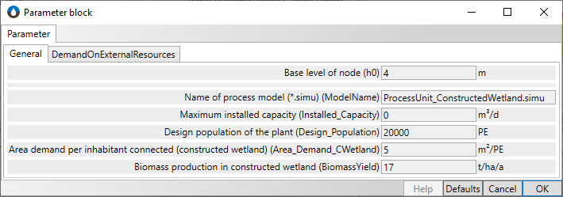
Rapid Planning – Example: Module „Constructed Wetland“
https://www.energieagentur.nrw
Constructed Wetland
https://www.ots.at/

Slide 52

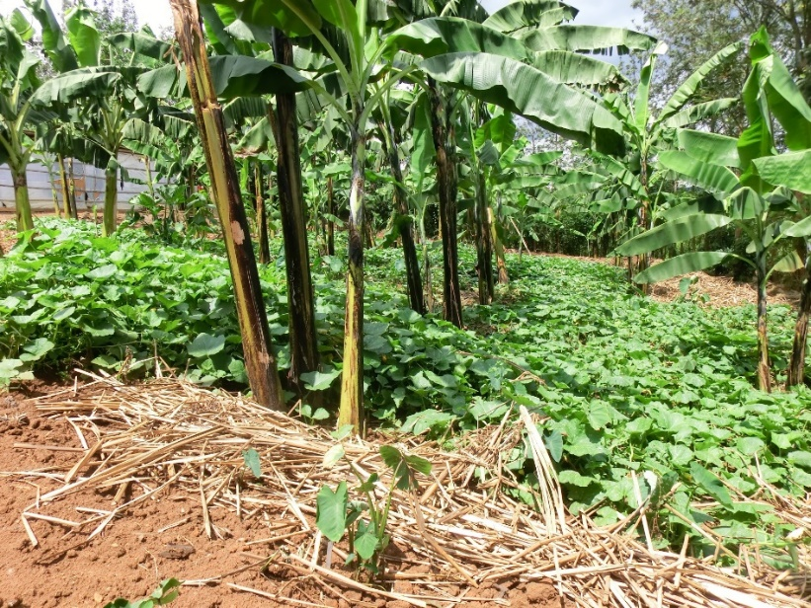
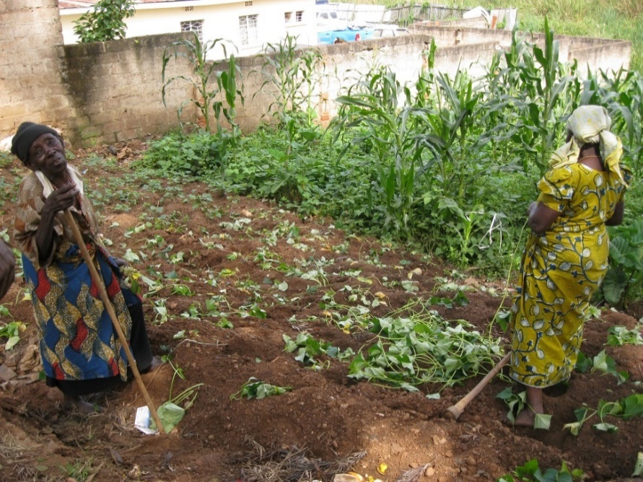


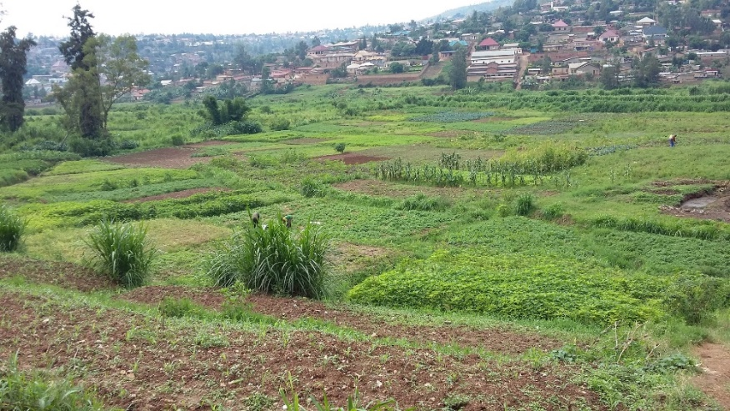
Rapid Planning – Example: Module „Agriculture“
Primary Agriculture - hillsides
Secondary Agriculture
Primary Agriculture - wetlands
Secondary Agriculture - wetlands
Primary Agriculture - wetlands

Slide 53
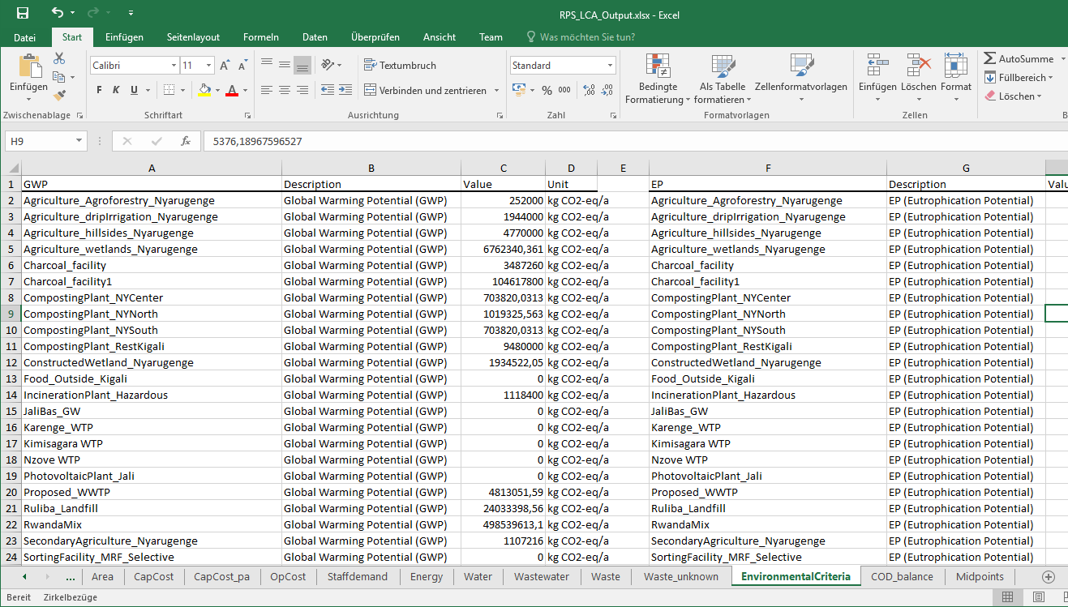
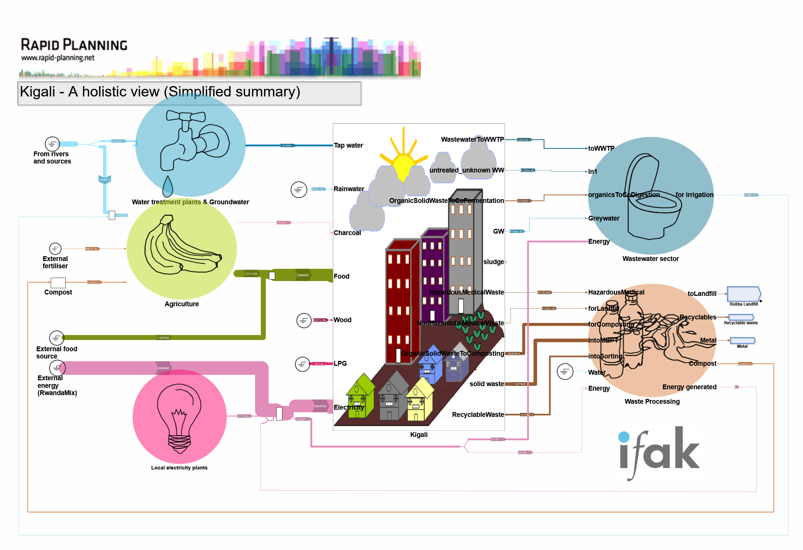

Rapid Planning – Scenario simulation for Kigali
Here: Trans-sectoral scenario
Output data:
Flows, concentrations of each flux in the system
Environmental information:
Greenhouse Gas emissions, …
Energy consumptions
Area demands
Import needs, ……

Slide 54

Rapid Planning – Scenario simulation for Kigali

Slide 55

Emission Categories in the Greenhouse Gas Balance of Companies According to the Greenhouse Gas Protocol
Scope 1: Emissions from sources that belong to the company (e.g. heating vessels, vehicles)
Scope 2: Emissions from use of purchased energy (e.g. electricity, heat, cooling)
Scope 3: Emissions from activities outside the company (e.g. purchase of products or sercices, commuting of personnel, waste management)
Source: https://ghgprotocol.org/sites/default/files/standards/Scope3_Calculation_Guidance_0.pdf

Slide 56


Mapping GHG Emissions – Hybrid Methodology
Top-Down Balance Input-Output tables link economic and GHG emission data (e.g. pharmaceuticals, medical products)
Bottom-Up Balance GHG emissions calculated based on consumption data using emission factors (e.g. electricity, fuel, anesthetics)
z.B. pharmaceuticals : 296 t CO₂-eq per million €
z.B. electricity (Germany): 0.48 kg CO₂-eq per kWh
Sources: ADEME, Eurostat
Notes:
The organizational boundaries define if an emission source is scope 1+2 or 3

Slide 57

Healthcare Without Harm: Climate Impact Checkup Tool

Slide 58

GHG-Balance for the Heidelberg University Hospital ecocockpit

Slide 59

GHG-Balance for the Heidelberg University Hospital in 2019 Values in tonnes (Mg) of CO₂-eq
Scope | t CO₂-eq/a | Share
Scope 1 | 6,600 | 2.9 %
Scope 2 | 50,300 | 21.0 %
Scope 3 | 172,500 | 75.2 %
Summe | 229,400 | 100 %
Scope 1
Scope 2
13.423 employees (2019) -> 17 t CO₂-eq per employee and year Turnover 2019: 1.3 bln € -> 180 t CO₂-eq per million €
Scope 3

Slide 60
Group work (10 teams @2 persons)
Group work (15 minutes)
Search for GHG emission factors for at least three food types - one vegetable or fruit - one meat or dairy product - one complete meal
Use Google search
Search in Base carbone Excel sheet Base Carbone - données V18.1.xlsx
Search for data in https://www.wri.org/food
Report back about results (15 minutes)

Slide 61
Thanks for your attention. Questions?
Bernd Franke and Team (bernd.franke@ifeu.de)

